Slide 1
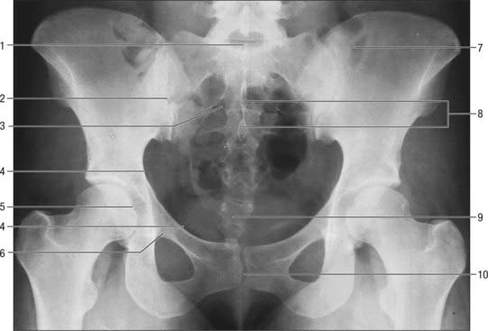
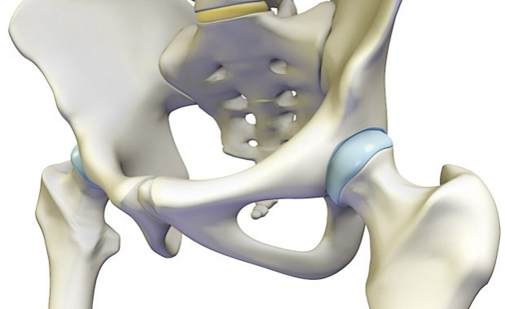
Hip Joint
5th December 2016
Anatomy Lecture
By: Dr Anita Rani

Slide 2
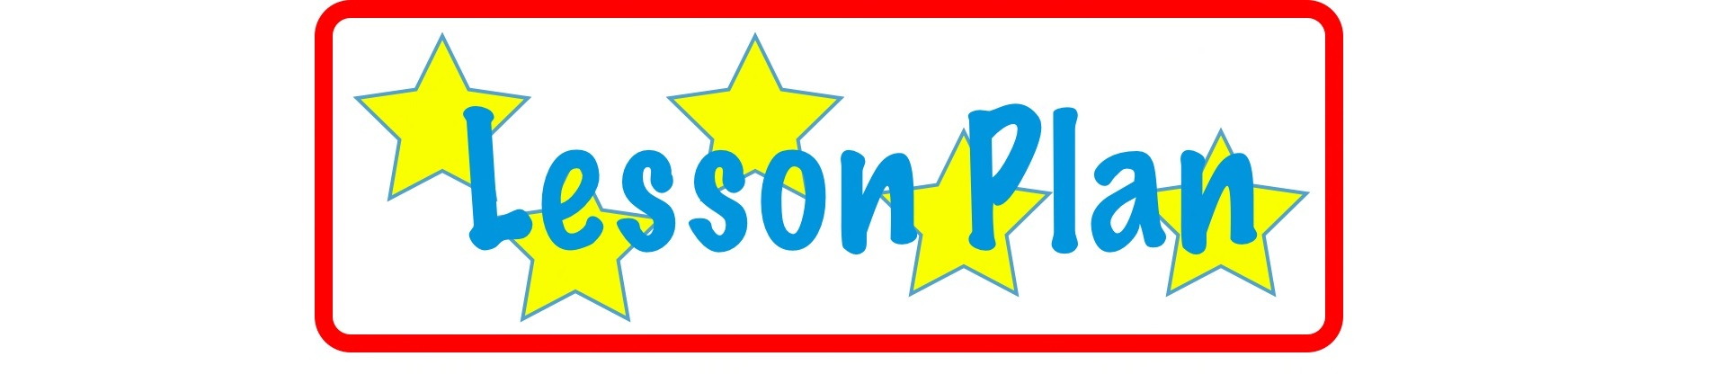
Type of Joint
Articular Surfaces
Ligaments
Relations
Blood Supply
Nerve Supply
Movements
Applied Anatomy

Slide 3
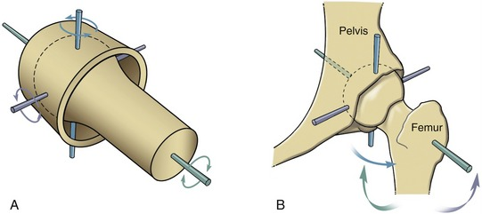
Type
Ball and Socket variety of Synovial Joint
Multiaxial
High Mobility with high stability

Slide 4
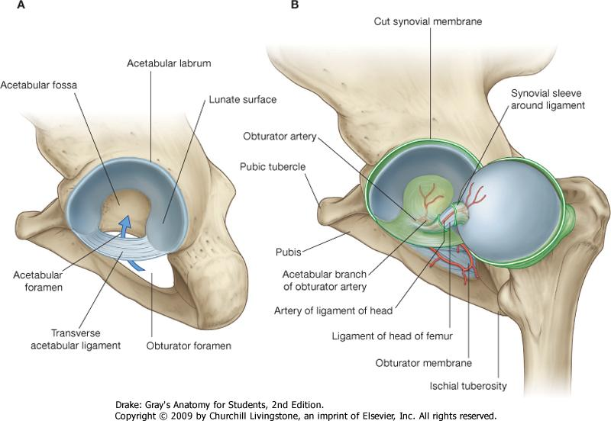
Articular Surfaces:
Reciprocal but not co-extensive
Head of Femur
Acetabulum
more than half of a sphere
covered by hyaline cartilage
EXCEPT at fovea capitis
Horse-shoe shaped lunate surface ( articular & covered by hyaline cartilage
Deep notch with narrow mouth
Articular notch
Acetabular fossa

Slide 5
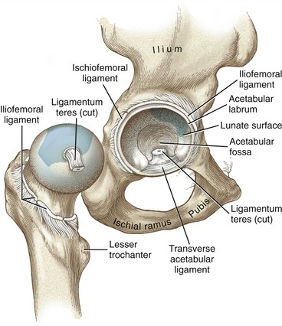
Ligaments
Fibrous capsule
Iliofemoral
Pubofemoral
Ischiofemoral
Ligament of head of femur
Acetabular labrum
Transverse acetabular ligament

Slide 6
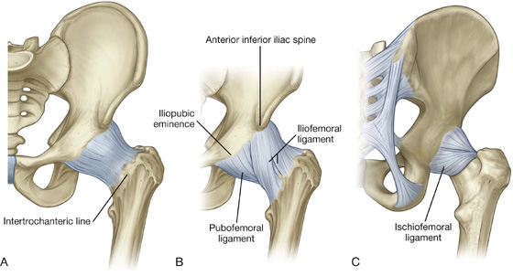
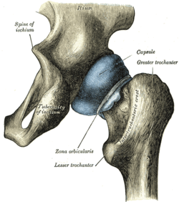
Fibrous capsule
Attachment
On hip bone: to the acetabular labrum including transverse acetabular ligament &
To the bone above and behind the acetabulum
On femur: to the intertrochanteric line infront and 1 cm medial to intertrochanteric crest behind

Slide 7
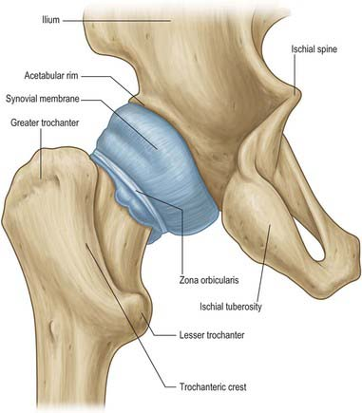
Fibrous capsule
Thick anterosuperiorly : part subjected to max tension in standing
Thin and loosely attached posteroinferiorly
2 type of fibres
outer longitudinal : many of them reflect to neck of femur K/s retinacula ( contain blood vessels supplying head and neck of femur)
inner circular K/s Zona Orbicularis

Slide 8
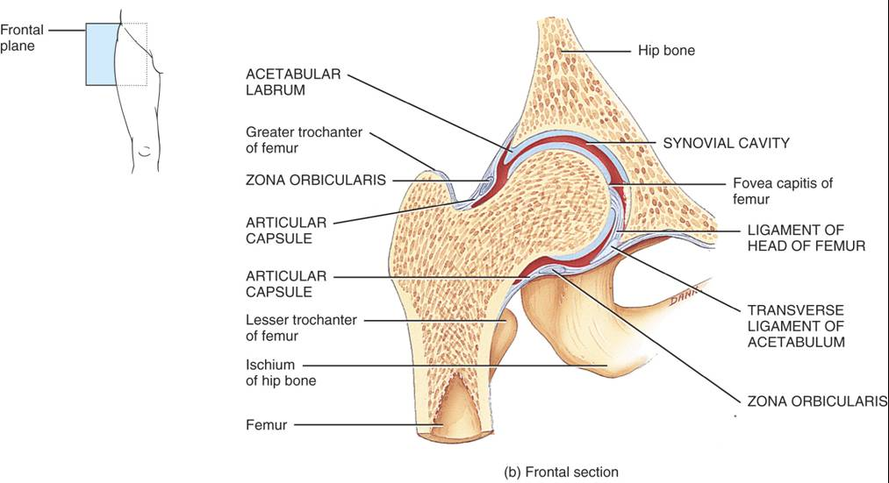
Synovial Membrane
Lines the fibrous capsule
Intracapsular portion of neck of femur
Both surfaces of acetabular labrum
Transverse ligament
Fat in acetabular fossa
Round ligament of head of femur

Slide 9
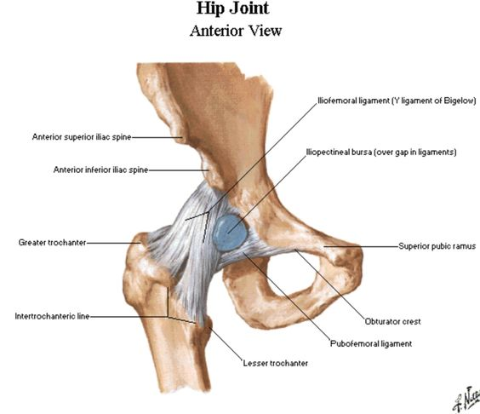
Joint Cavity
Communicates with the subtendinous bursa beneath the tendon of psoas major, through a circular opening in the capsule between pubofemoral and vertical band of iliofemoral ligaments.

Slide 10
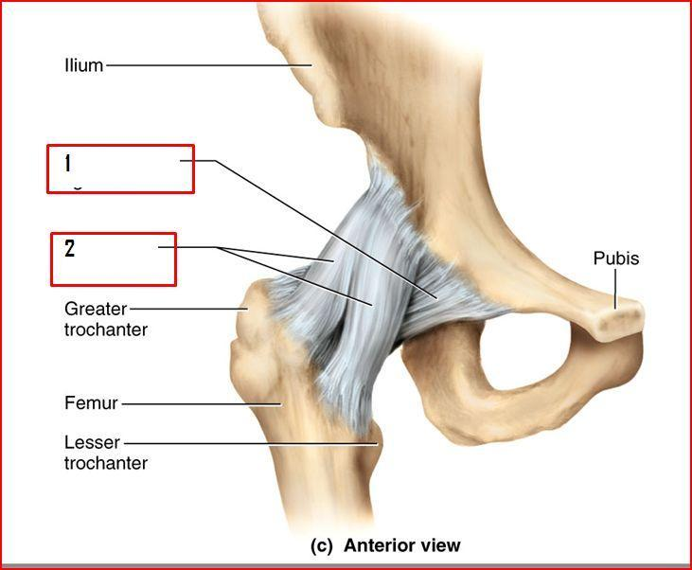
Iliofemoral Ligament
Inverted Y shaped : triangular
Ligament of BIGELOW
Strongest ligament of body: resist the trunk falling backwards in standing posture
Apex : lower half of ASIS
Base: inter-trochanteric line
The upper (oblique) and lower (vertical) fibres form thick,strong bands, while the middle fibres are thin and weak

Slide 11
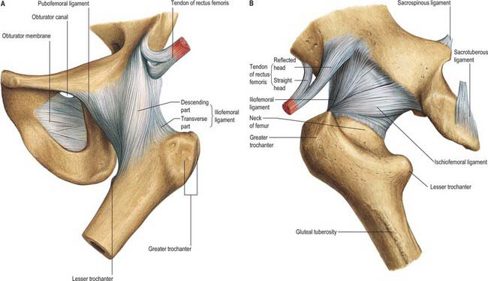
Pubofemoral Ligament
Supports the joint inferomedially
Triangular
Superiorly, it is attached to the iliopubic eminence, obturator crest and obturator membrane
Inferiorly, it marges with the anteroinferior part of the capsule and lower band of iliofemoral ligament

Slide 12
Ischifemoral Ligament
Comparitively weak, and covers the joint posteriorly
Fibres are twisted and extend from ischium posteroinferior to the acetabulum, form the zona orbicularis, and few fibres to the greater trochanter

Slide 13
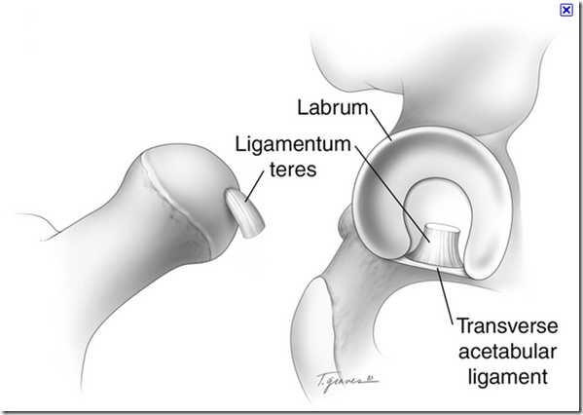
Ligament Of the Head of Femur
Round ligament or ligamentum teres
Flat, triangular ligament
Apex : fovea capitis
Base: transverse ligament and margins of the acetabular notch
Very thin / even absent
Transmits arteries to the head of femur from the acetabular branches of the obturator and medical circumflex femoral arteries.

Slide 14
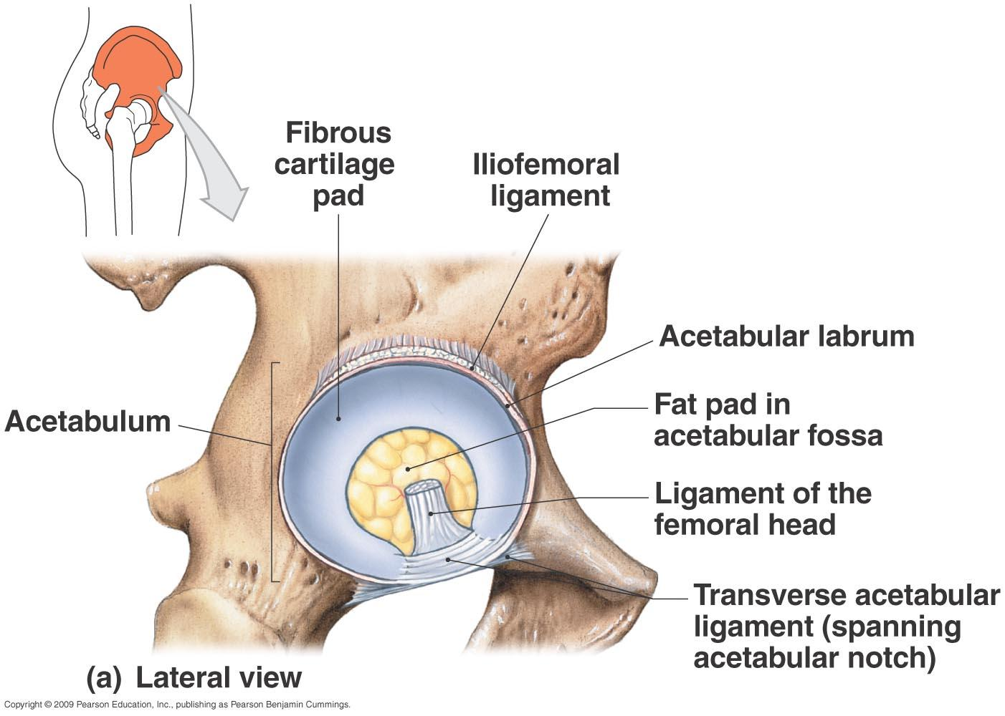
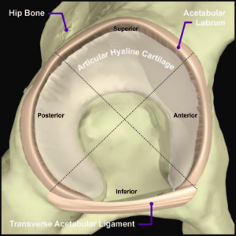
Acetabular Labrum
Cotyloid ligament
Fibrocartilagenous rim attached to the margins of acetabulum
Narrows the mouthy of acetabulum which helps in holding the head of femur in position

Slide 15
Transverse Ligament of Acetabulum
A part of the labrum which bridges the acetabular notch, but it has no cartilage cells
The notch thus converted into a foramen transmits vessels (acetabular) and nerves to the joint

Slide 16
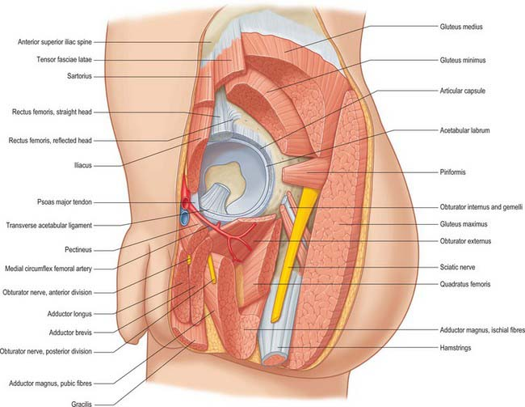
Relations
Anterior
Lateral fibres of pectineus covered by femoral veins
Iliopsoas with femoral nerve separating the iliacus bursa from femoral artery
Straight head of rectus femoris covering the deep layer of iliotibial tract

Slide 17
Relations
Posterior
Quadratus femoris covering obturator externus and the ascending branch of medial circumflex femoral artery
Obturator internus with Two gemelli separate the sciatic nerve from the nerve to Quadratus femoris
Piriformis

Slide 18
Relations
Superior
Reflected head or rectus femoris covered by gluteus minimus
Inferior
Lateral fibres of pectineus and obturator externus

Slide 19
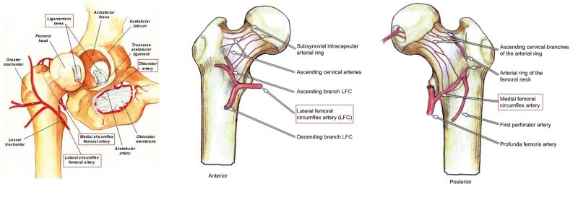
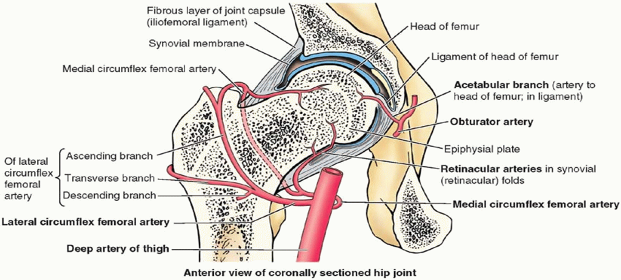
Blood Supply
Obturator
Two circumflex femoral
Two gluteal arteries
Medial and lateral circumflex femoral arteries form an arterial circle around the capsular attachment on the neck of femur
Retinacular arteries arise from this circle and supply the intracapsular neck and greater part of the head of femur.
A small part of the head near the fovea capitis is supplied by the acetabular branches of the obturator and medial circumflex femoral arteries

Slide 20
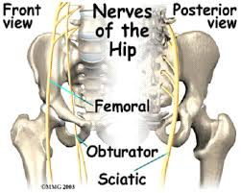
Nerve Supply
Hip joint is supplied by:
The femoral nerve, through the nerve to rectus femoris
Anterior division of obturator nerve
Accessory obturator nerve
Nerve to quadratus femoris
The superior gluteal nerve

Slide 21
Movements
Flexion and extension occur around a transverse axis
Adduction and abduction occur around a anteroposterior axis
Medial and lateral rotations occur around a vertical axis
Circumduction is a combination of the foregoing movements

Slide 22
Muscles producing Movement
Flexion-Psoas major and iliacus
Extension-Gluteus maximus and hamstrings
Adduction-Adductors longus,brevis and magnus
Abduction-Glutei medius and minimus
Medial Rotation- Tensor fasciae latae and the anterior fibres of glutei medius and minimus
Lateral rotation-Two obturators, two gemelli and quadratus femoris

Slide 23
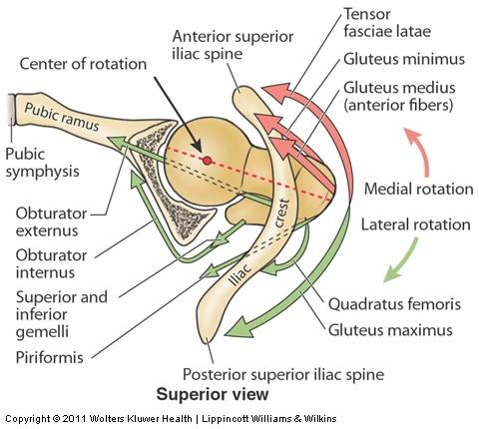

Slide 24
Applied Anatomy
Diseases of the hip joint
Interesting age pattern
Below 5 years: Congenital dislocation and tuberculosis
5 to 10 years: Perthes’ disease
10 to 20 years: Coxa vera
Above 40 years: Osteoarthritis

Slide 25
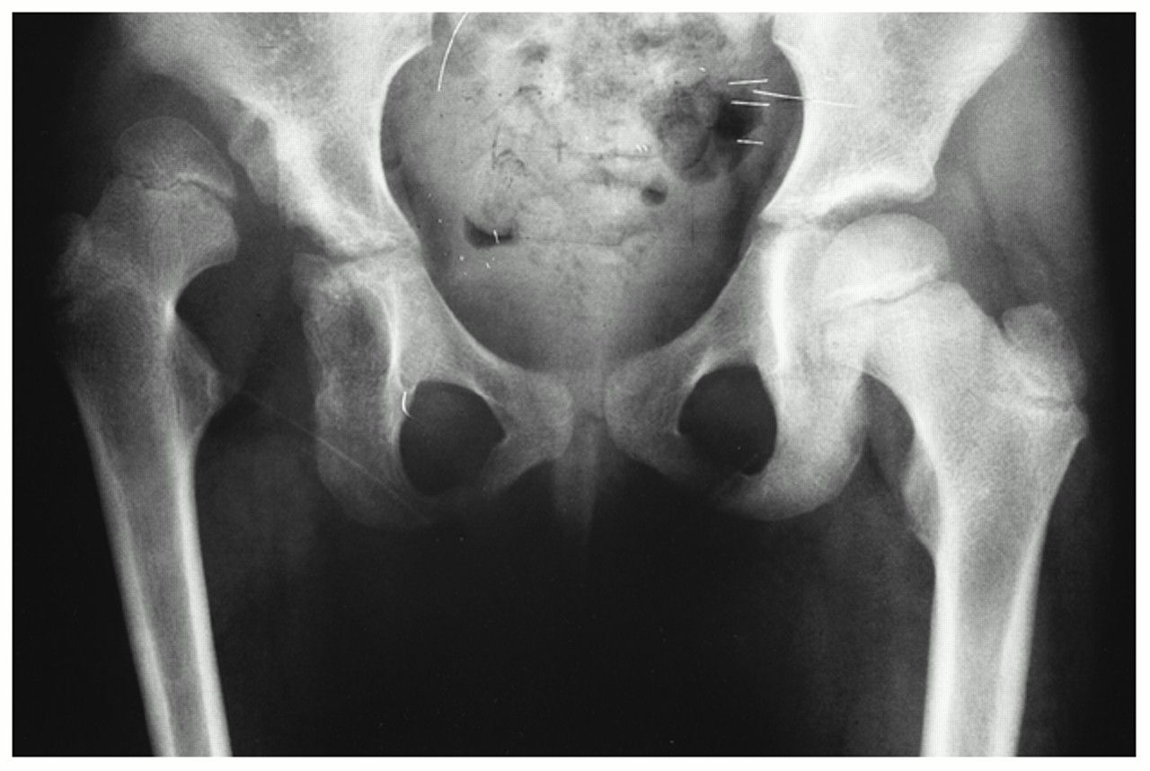
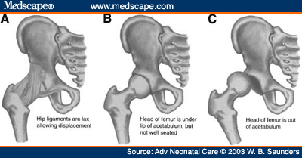
Congenital Dislocation
More common in the hip than any other joint of the body
The head of the femur slips upwards onto the gluteal surface of the ilium because the upper margin of acetabulum is developmentally deficient
This causes lurching gait, and the Trendelenburg’s test is positive.

Slide 26
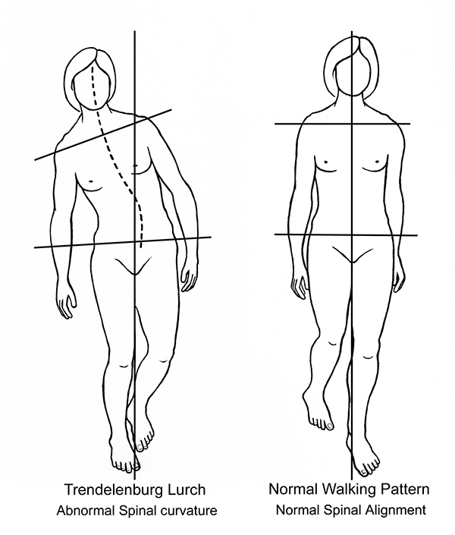

Slide 27
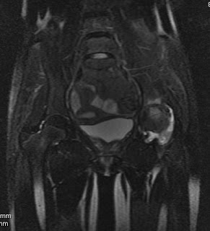
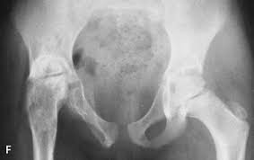
Tuberculosis
Osseous destruction & marrow edema involving the bones forming hip articulation along with synovial collection & reduced joint space.

Slide 28
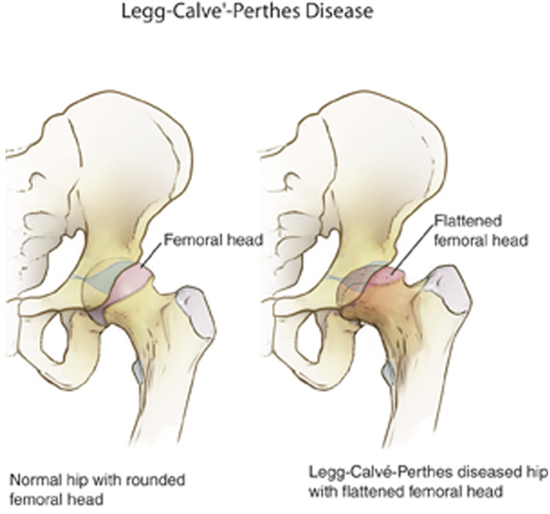
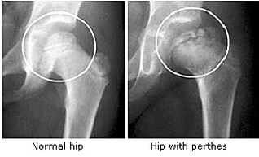
Perthes’ Disease(pseudocoxalgia)
It is characterised by destruction and flattening of the head of femur, with an increased joint space in x-ray pictures

Slide 29
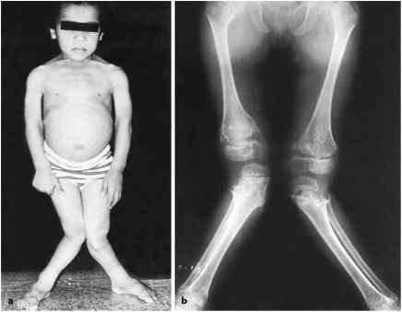
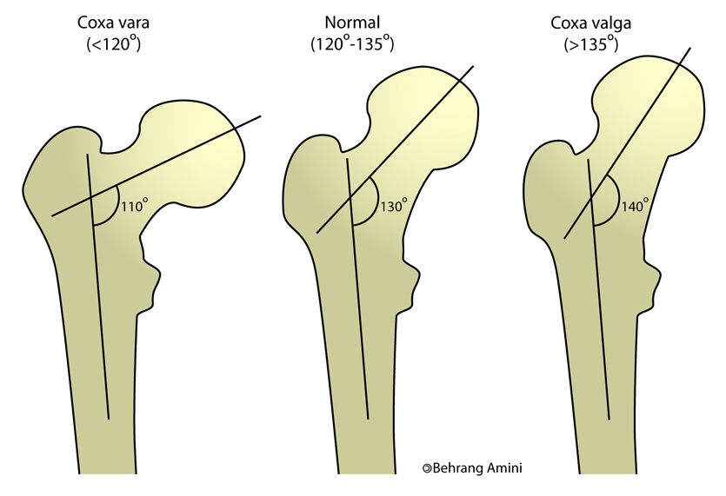
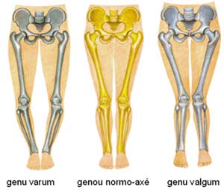
Coxa Vera & Valga
A condition in which the neck-shaft angle is reduced from the normal of about 150 degree in a child and 127 degree in an adult

Slide 30
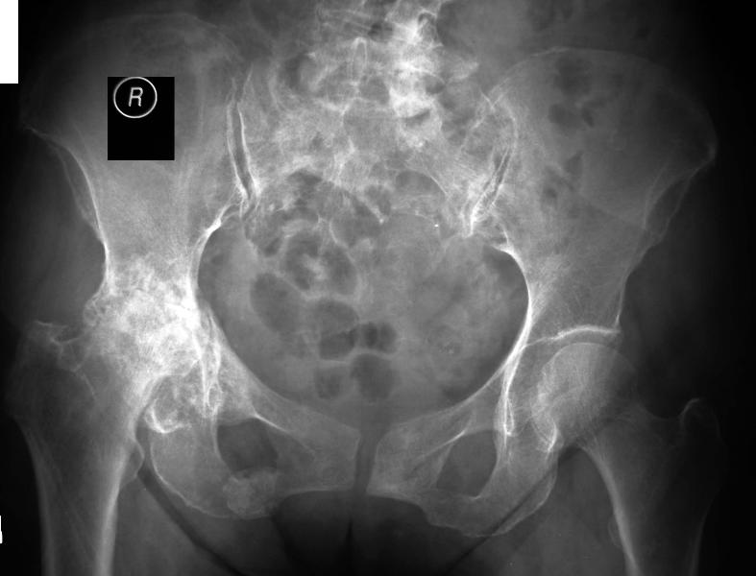
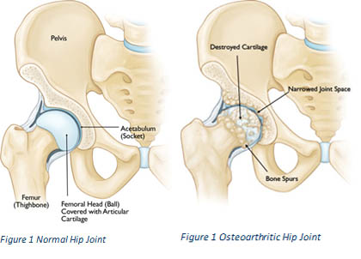
Osteoarthritis
disease of old age
characterised by growth of osteophytes at the articular ends, which make the movemens limited, grating and painful.

Slide 31
Applied Anatomy
B. Injuries of the hip joint
a definite age pattern
Young age : Greenstick fractures of the neck, and displacement of the head, of femur
Adulthood : Dislocation of hip joint
Old age : Fracture of the neck of femur

Slide 32
Dislocation of the Hip
It may be posterior(more common), anterior(less common), or central (rare). The sciatic nerve maybe injured in posterior dislocations.

Slide 33
Fracture of the Neck of Femur
It may be subcapital(near the head), cervical (in the middle) or basal (near trochanters).
Damage to retinacular arteries causes avascular necrosis of the head.
Such a damage is maximum in subcapital and least in basal fractures
These fractures are common in old age, between 40 and 60 years
Fracture-neck-femur is usually produced by trivial injuries , like tripping over some minor obstruction.
The patient falls down and cannot get up.
The limb lies helplessly rolled out, as if paralysed. X-rays confirm the diagnosis.

Slide 34
Trochanteric Fracture
Intertrochanteric(between the Trochanters)
Peritrochanteric(along the Trochanters) or
Subtrochanteric(below the trochanters).
These fractures occur in strong, adult subjects, and are produced by severe, violent injuries.

Slide 35
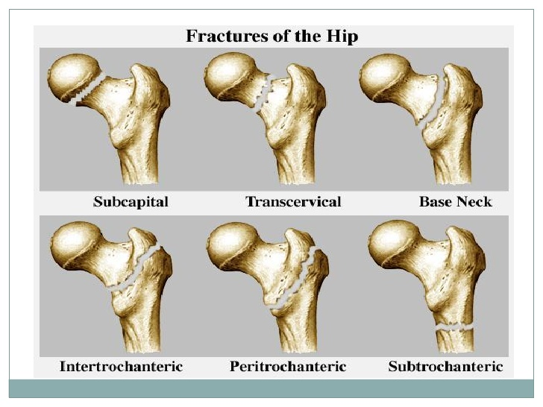

Slide 36
Applied Anatomy
Shortening of the lower limb
By fractures/dislocation and tuberculosis
The length of the lower limb is measured from anterior superior iliac spine to medical malleolus

Slide 37
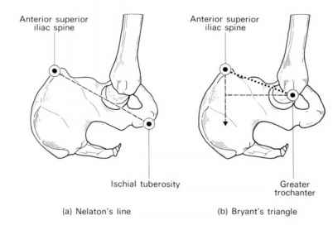
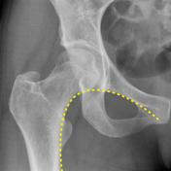
Displacement of the greater Trochanter
(in fractures and dislocations)
Shenton’s line
Nelaton’s Line /Bryant’s triangle

Slide 38
Applied Anatomy
Disease of the hip, like tuberculosis, may cause referred pain in the knee because of the common nerve supply of the two joints.

