Slide 1
THE ELEMENTS OF PROBABILITY AND STATISTICS

Slide 2
There are two basic types of relationships:
A deterministic
(or functional) relationship is an exact relationship between the predictor variable x and the response y.
(: y = a x + b)
A statistical relationship is not an exact relationship.
It is instead a relationship in which "trend" exists between the predictor x and the response y, but there is also some "scatter."
(the relationship between height and weight)

Slide 3
A measure of uncertainty or a numerical value expressing the degree of uncertainty regarding the occurrence of an event is called probability

Slide 4
The probability of a random event is a measure of the likelihood that the event will occur
A probability measures the chance of a given event occurring

Slide 5
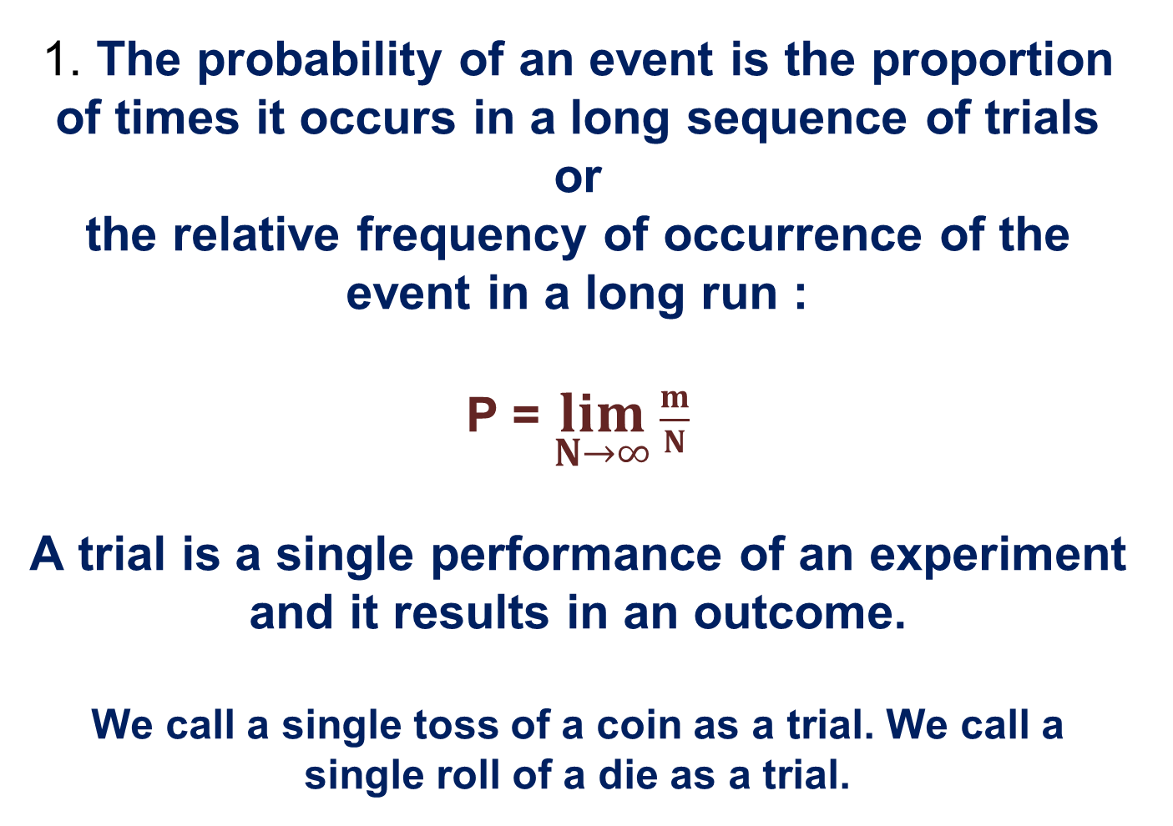
  1. The probability of an event is the proportion of times it occurs in a long sequence of trials or the relative frequency of occurrence of the event in a long run :
  P = $\lim_{N→∞}{\frac{m}{N}}$
  A trial is a single performance of an experiment and it results in an outcome.
  We call a single toss of a coin as a trial. We call a single roll of a die as a trial.

Slide 6
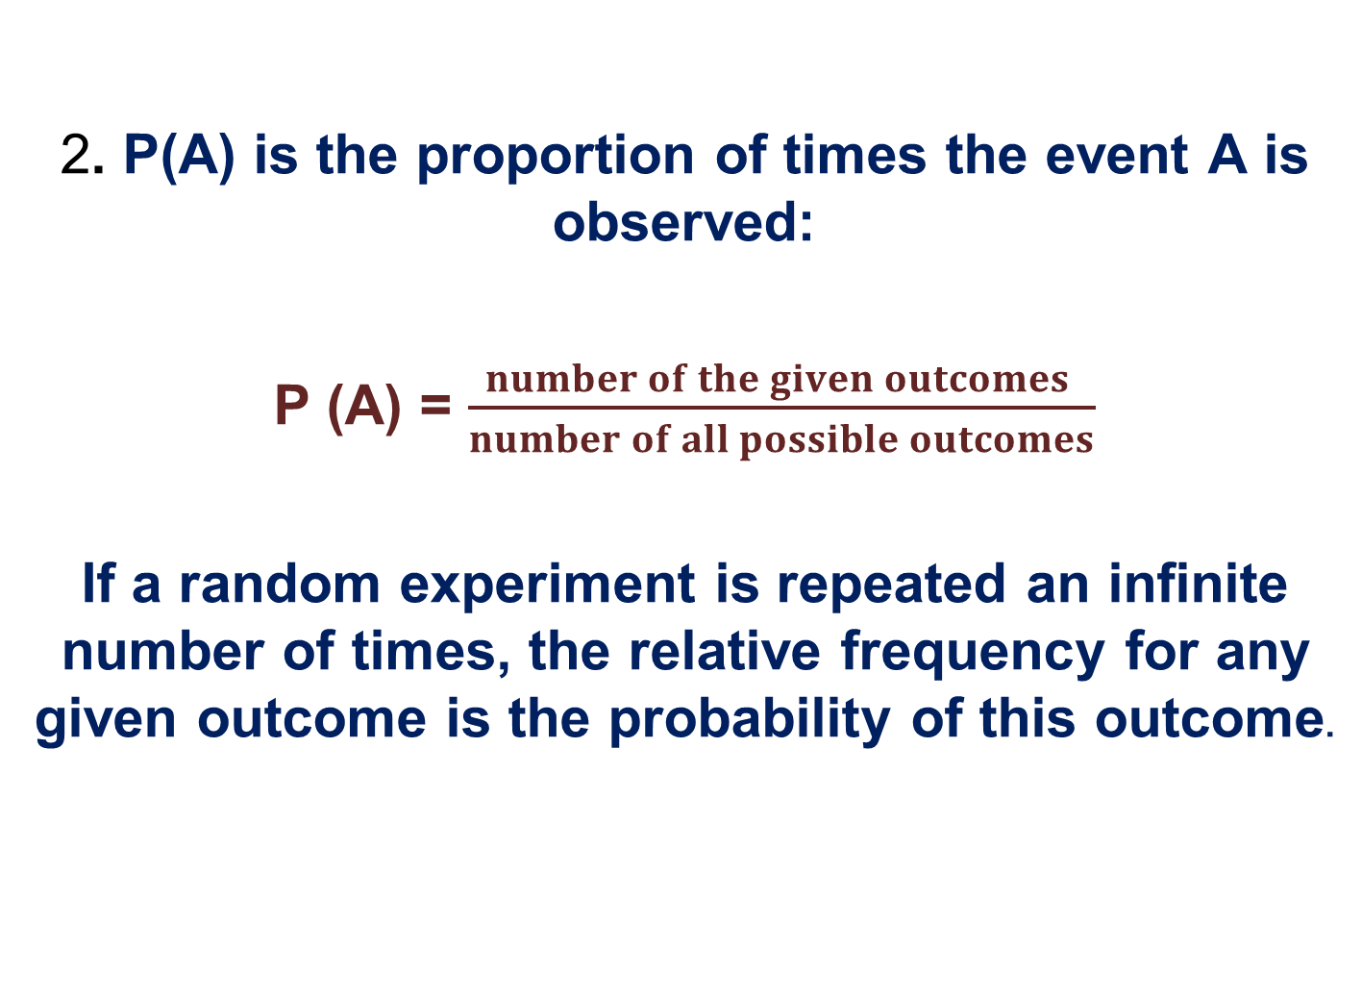
  2. P(A) is the proportion of times the event A is observed:
  P (A) = $\frac{number of the given outcomes }{number of all possible outcomes}$
  If a random experiment is repeated an infinite number of times, the relative frequency for any given outcome is the probability of this outcome.

Slide 7
Experiment – Event – Outcome –
Sample space – Sample points
An experiment is an activity or procedure that produces distinct, well-defined possibilities called outcomes.
Tossing a coin, rolling a die, extracting a ball from a box are experiments.
The set of all outcomes is called the sample space
The elements of a sample space are called sample points
A random event is an event that either happens or fails to happen as a result of an experiment.
For example:
We are throwing a coin into the air and then we guess which side it will land on, heads or tails
We are rolling a die and then we guess which number will show up

Slide 8
If our experiment is to toss a coin which has two sides then there are two outcomes: heads and tails.
Tossing a coin experiment
S : {Head, Tail}
If our experiment is to roll a die whose faces are marked with the six numerical symbols or numbers 1; 2; 3; 4; 5; 6 then there are six outcomes corresponding to the number that shows on the top.
Thus, the sample space for this experiment is 1; 2; 3; 4; 5; 6.
S : {1, 2, 3, 4, 5, 6}

Slide 9
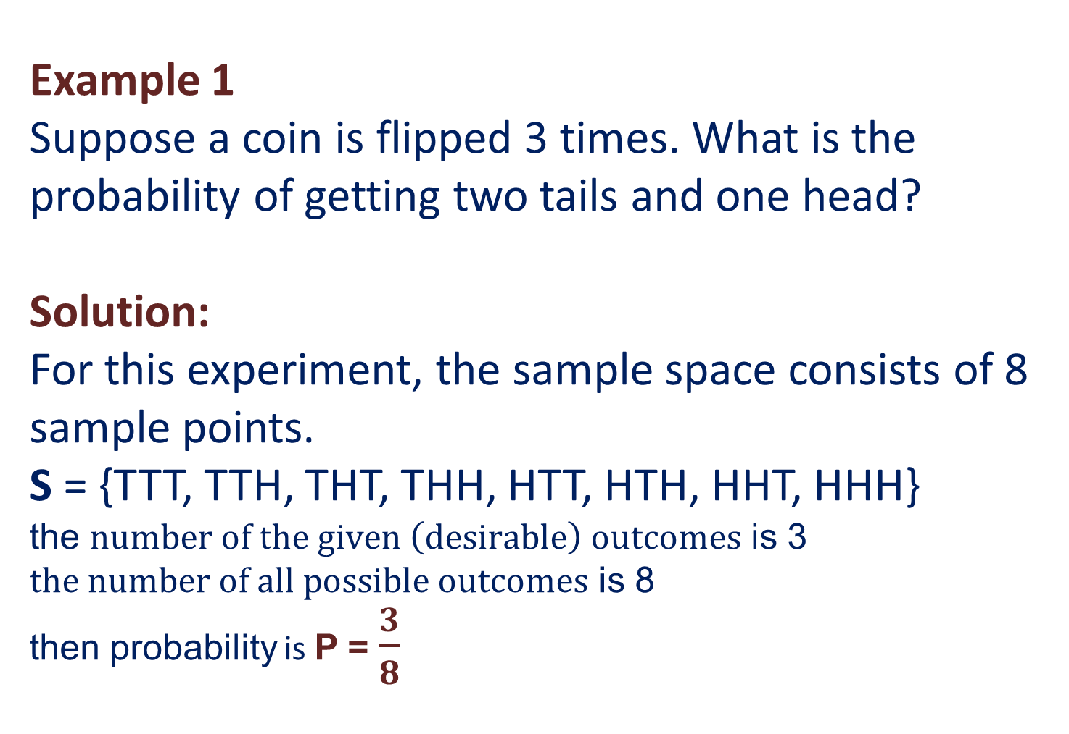
Example 1
Suppose a coin is flipped 3 times. What is the probability of getting two tails and one head?
Solution:
For this experiment, the sample space consists of 8 sample points.
S = {TTT, TTH, THT, THH, HTT, HTH, HHT, HHH} the $number of the given \left(desirable\right) outcomes$ is 3
$the number of all possible outcomes$ is 8 then probability is P = $\frac{3}{8}$

Slide 10
Types of random events
  Mutually exclusive events:
  Two events A and B are said to be mutually exclusive or disjoint if the occurrence of event A excludes the occurrence of event B in the same trial
  Events E₁, E₂, ..., E_{n} are said to be mutually exclusive if the occurrence of any one of them implies the non-occurrence of the remaining (n − 1) events
  For example:
  the occurrence of Head excludes the occurrence of Tail
  Independent events:
  Two events A and B are said to be independent if the occurrence of one of them does not influence the occurrence of another
  (does not affect the probability of occurrence of the other).
  For example:
  the occurrence of Head in one trial does not influence the outcome of any other trial - occurrence of Head or Tail in the following trials.

Slide 11
Types of random events
  Compatible events:
  Two events A and B are compatible if they can occur at the same time (simultaneously).
Incompatible events:
Two events A and B are incompatible if they cannot occur at the same time (simultaneously).

Slide 12
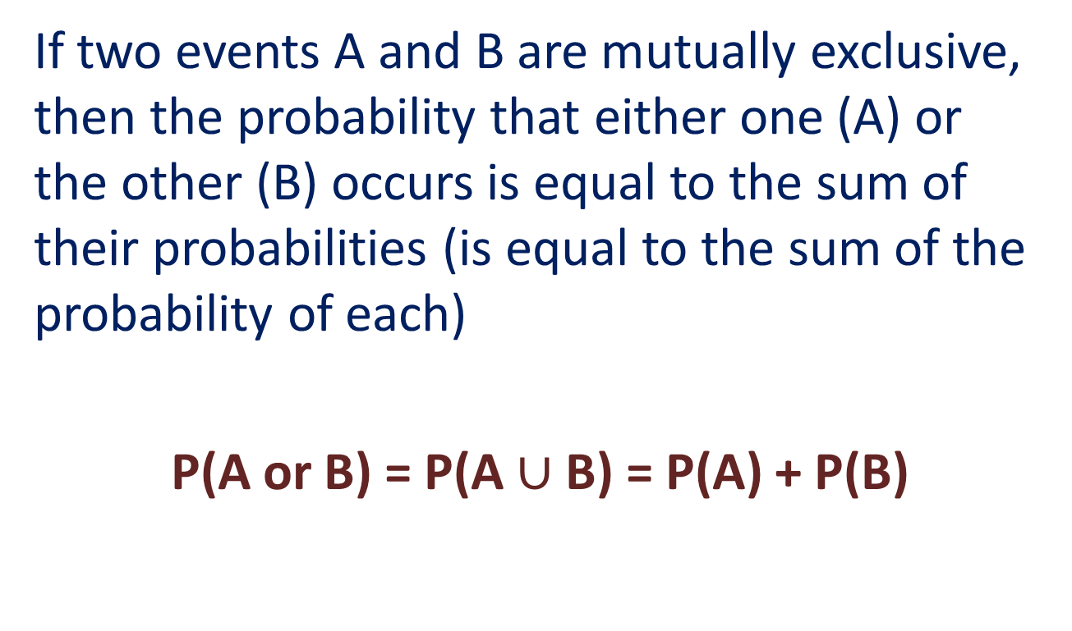
The addition rule:
If two events A and B are mutually exclusive, then the probability that either one (A) or the other (B) occurs is equal to the sum of their probabilities (is equal to the sum of the probability of each)
P(A or B) = P(A $∪$ B) = P(A) + P(B)

Slide 13
Example 2
Suppose a coin is flipped 3 times. What is the probability of getting two tails and one head?
Solution: For this experiment, the sample space consists of 8 sample points:
S = {TTT, TTH, THT, THH, HTT, HTH, HHT, HHH}
Each sample point is equally likely to occur, so the probability of getting any particular sample point is 1/8. The event "getting two tails and one head" consists of the following subset of the sample space.
A = {TTH, THT, HTT}
The probability of Event A is the sum of the probabilities of the sample points in A. Therefore,
P(A) = 1/8 + 1/8 + 1/8 = 3/8

Slide 14
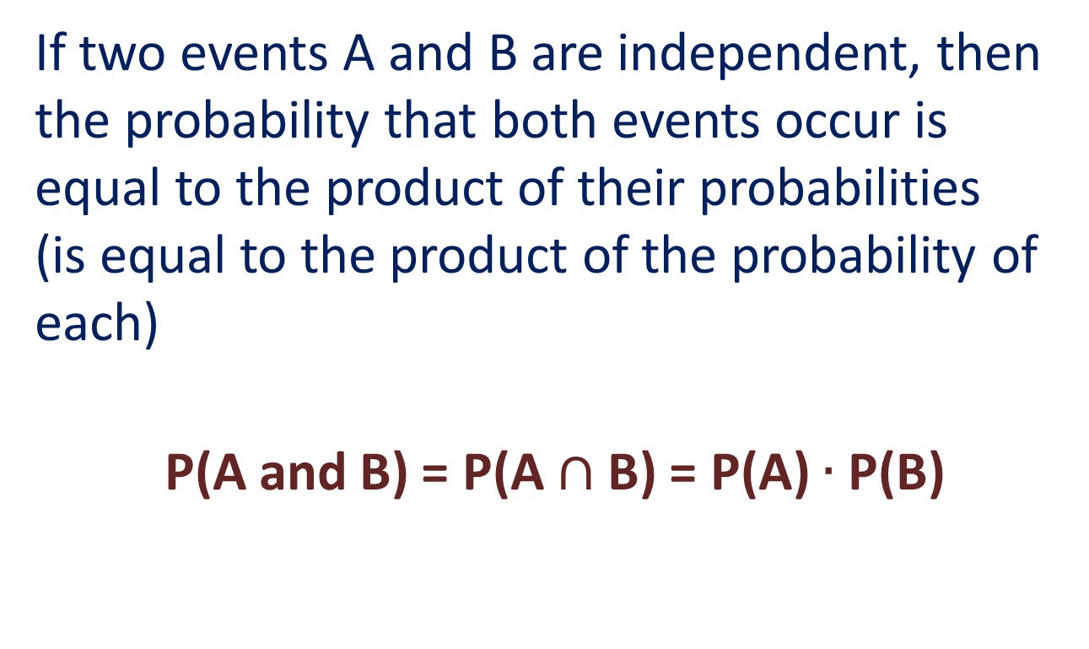
The multiplication rule:
If two events A and B are independent, then the probability that both events occur is equal to the product of their probabilities
(is equal to the product of the probability of each)
P(A and B) = P(A $∩$ B) = P(A) $∙$ P(B)

Slide 15
Example 3.1
Suppose we draw a card from a deck of playing cards. What is the probability that we draw a spade?
Solution: The sample space of this experiment consists of 52 cards, and the probability of each sample point is 1/52. Since there are 13 spades in the deck, the probability of drawing a spade is
P (Spade) = (13)(1/52) = 1/4

Slide 16
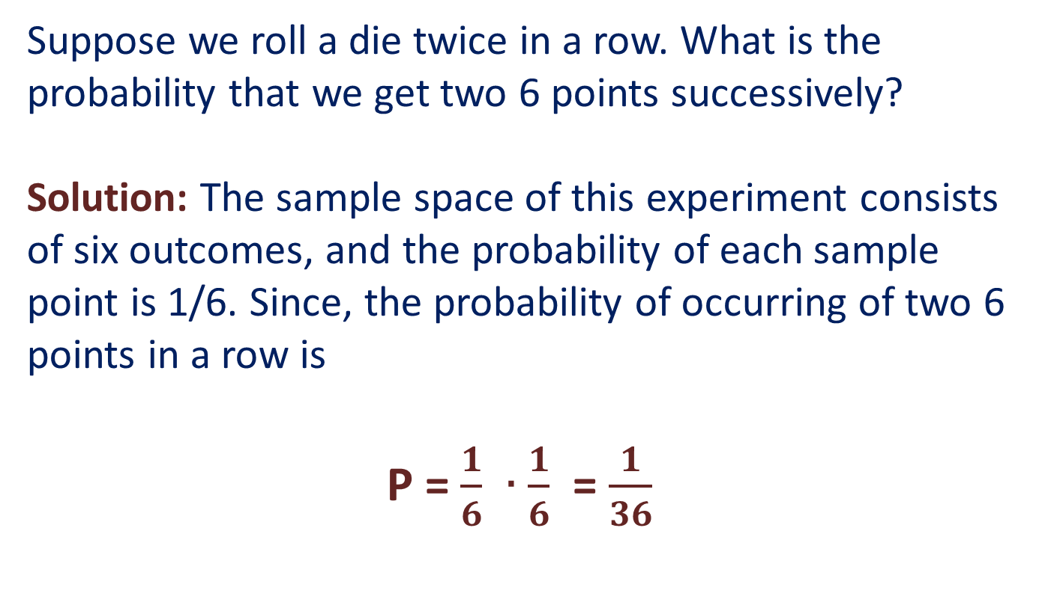
Example 3.2
Suppose we roll a die twice in a row. What is the probability that we get two 6 points successively?
Solution: The sample space of this experiment consists of six outcomes, and the probability of each sample point is 1/6. Since, the probability of occurring of two 6 points in a row is
P = $\frac{1}{6} ∙$ $\frac{1}{6}$ = $\frac{1}{36}$

Slide 17
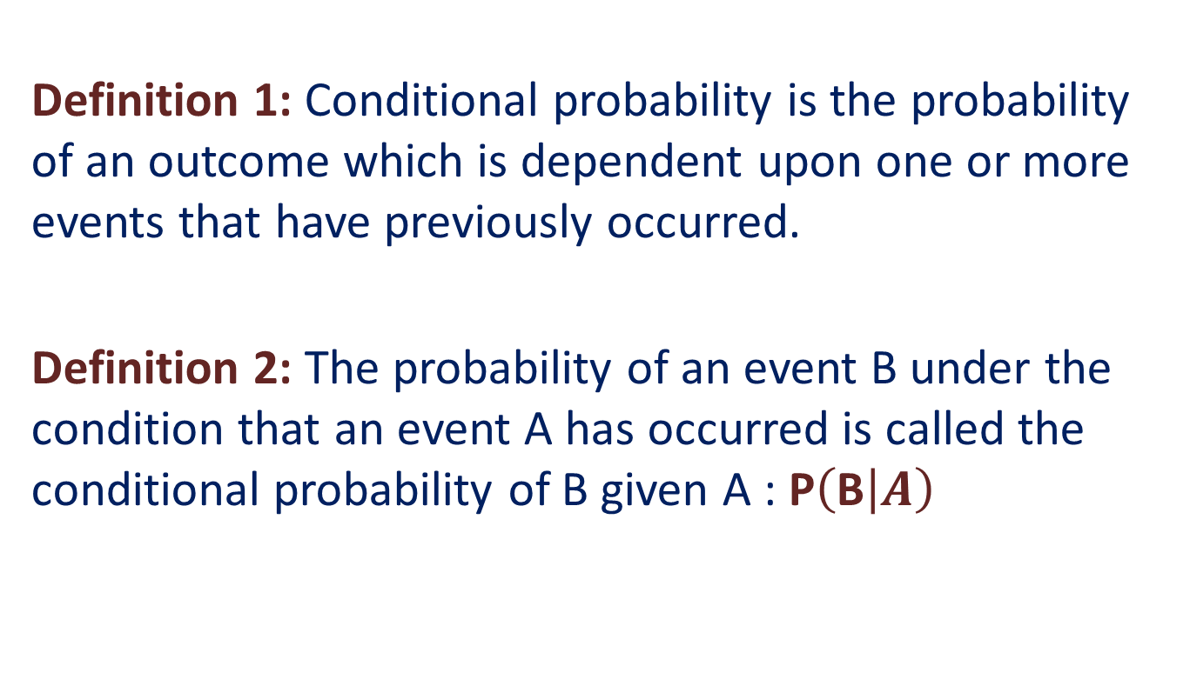
Conditional Probability
Definition 1: Conditional probability is the probability of an outcome which is dependent upon one or more events that have previously occurred.
Definition 2: The probability of an event B under the condition that an event A has occurred is called the conditional probability of B given A : P$\left(\text{B} | A\right)$

Slide 18
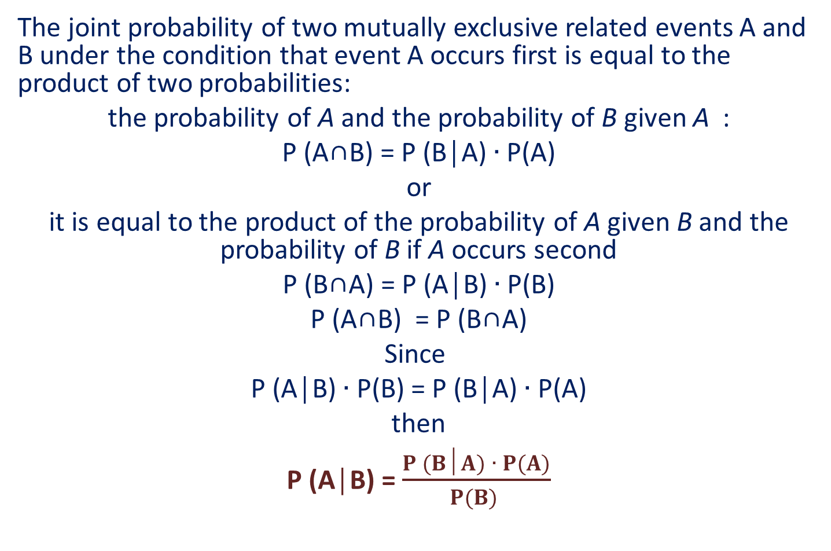
Bayes’ Theorem
The joint probability of two mutually exclusive related events A and B under the condition that event A occurs first is equal to the product of two probabilities:
the probability of A and the probability of B given A :
P (A∩B) = P (B│A) $∙$ P(A)
or
it is equal to the product of the probability of A given B and the probability of B if A occurs second
P (B∩A) = P (A│B) $∙$ P(B)
P (A∩B) = P (B∩A)
Since
P (A│B) $∙$ P(B) = P (B│A) $∙$ P(A)
then
P (A│B) = $\frac{P (B│A) ∙ P(A)}{P(B) }$

Slide 19
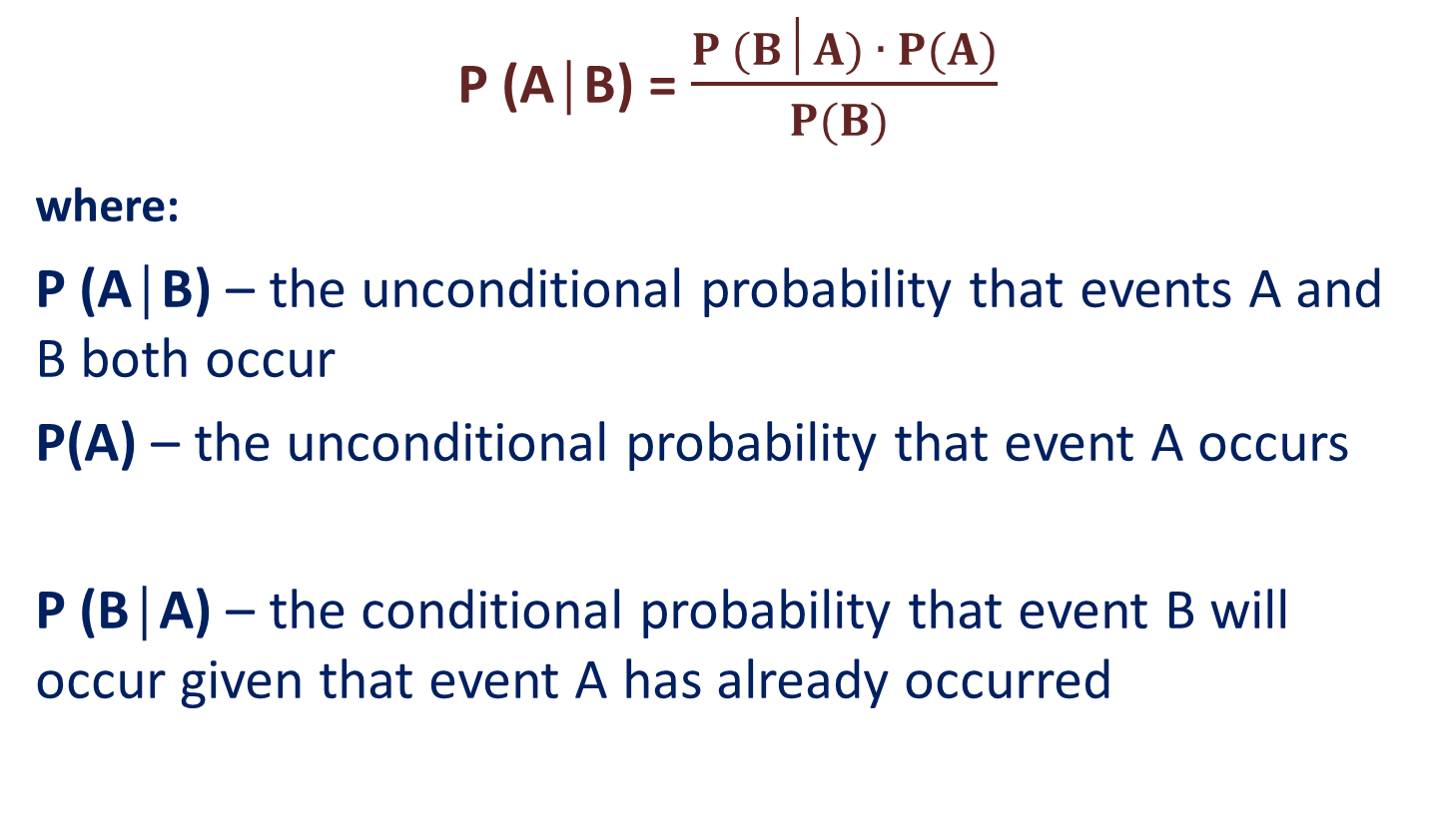
Bayes’ Theorem
P (A│B) = $\frac{P (B│A) ∙ P(A)}{P(B) }$
where:
P (A│B) – the unconditional probability that events A and B both occur
P(A) – the unconditional probability that event A occurs
P (B│A) – the conditional probability that event B will occur given that event A has already occurred

Slide 20
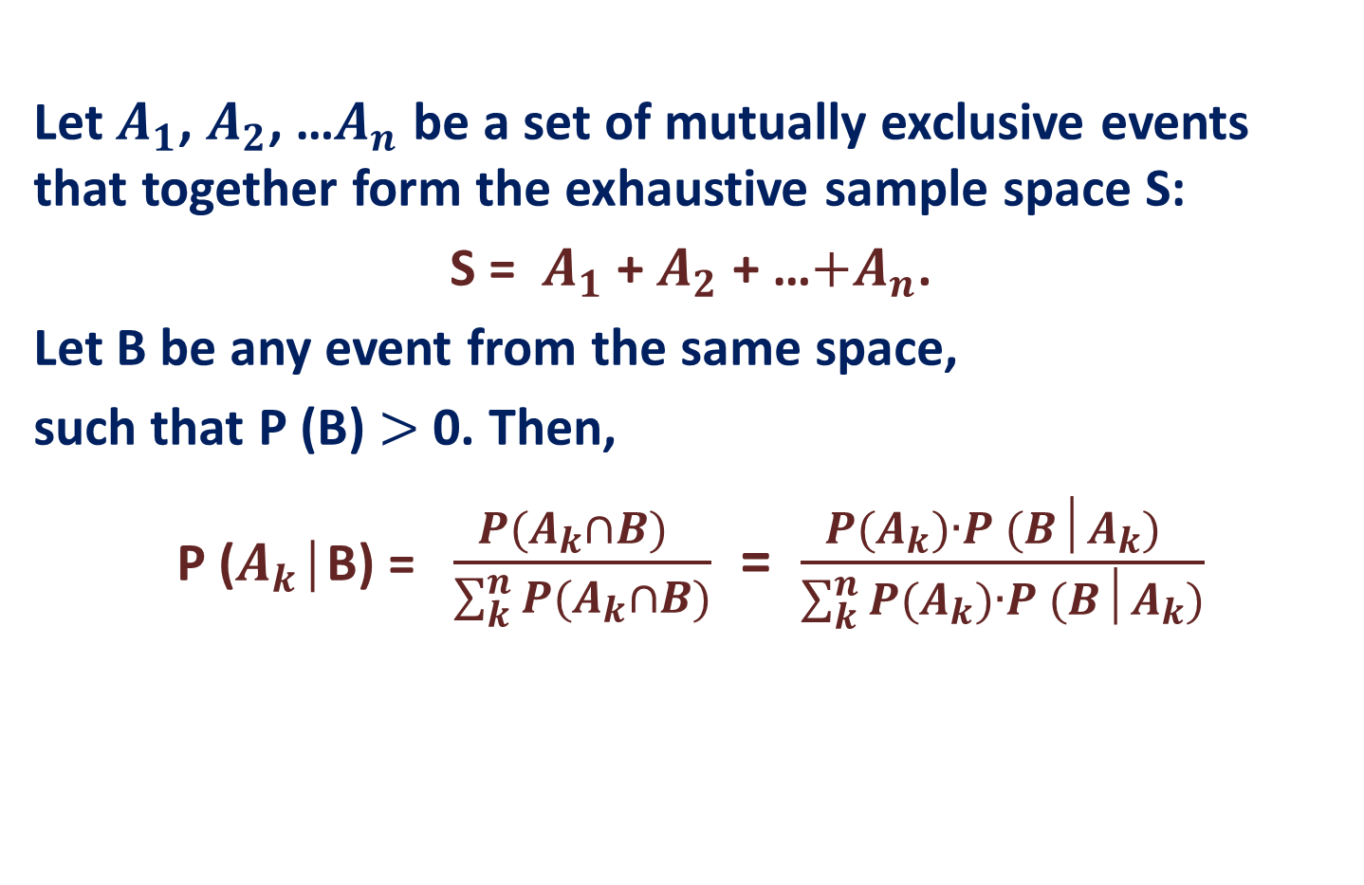
Bayes’ Theorem
Let $A_{1}$, $A_{2}$, …$A_{n}$ be a set of mutually exclusive events that together form the exhaustive sample space S:
S = $A_{1}$ + $A_{2}$ + …$+A_{n}$.
Let B be any event from the same space,
such that P (B) $>$ 0. Then,
P ($A_{k}$│B) = $\frac{P(A_{k}∩B) }{\sum_{k}^{n}{P(A_{k}∩B)}}$ = $\frac{P(A_{k})∙P (B│A_{k}) }{\sum_{k}^{n}{P(A_{k})}∙P (B│A_{k})}$

Slide 21
Basic notions of Statistics
Population:
- the collection of all items of interest in a particular study.
- an entire group of individuals in whom we are interested.
Target Population:
The population about which we want to draw inferences.
Sampled Population:
The actual population from which the sample has been taken.

Slide 22
Sample:
a set of data drawn from the population;
a part (subset) of the population taken into consideration (which is actually extracted from the population and believed to be representative of that population) in order to get information (to draw conclusions, to make inferences) about the population as a whole.
PARAMETER: A descriptive measure of the population.
VARIABLE: A characteristic of interest about each element of a population or sample.

Slide 23
random variable :
A variable whose value is a number determined by the elementary event resulting from an experiment.
Discrete random variable :
a variable which can take a value from a discrete set of numbers.
* Discrete random variables appear in an experiment in which we count.
Continuous random variable :
a variable which can take any value within a given range.
* Continuous random variables appear in an experiment in which we measure.

Slide 24
Distribution of the random variable :
-If X is a random variable which can take the values:
x1, x2, …., xN with the probabilities p(x1), p(x2), …, p(xN), then the set of ordered pairs (xi; p(xi)), i = (1; N) is called the probability distribution of the random variable X.
Distribution Function (Cumulative distribution function (CDF):
The function F (x) evaluated at x, is the probability that X will take a value less than or equal to x : F (x) = P (X ≤ x)
* The probability that X lies in the semi-closed interval (a,b] :
P (a < X ≤ b) = F (b) – F (a)

Slide 25
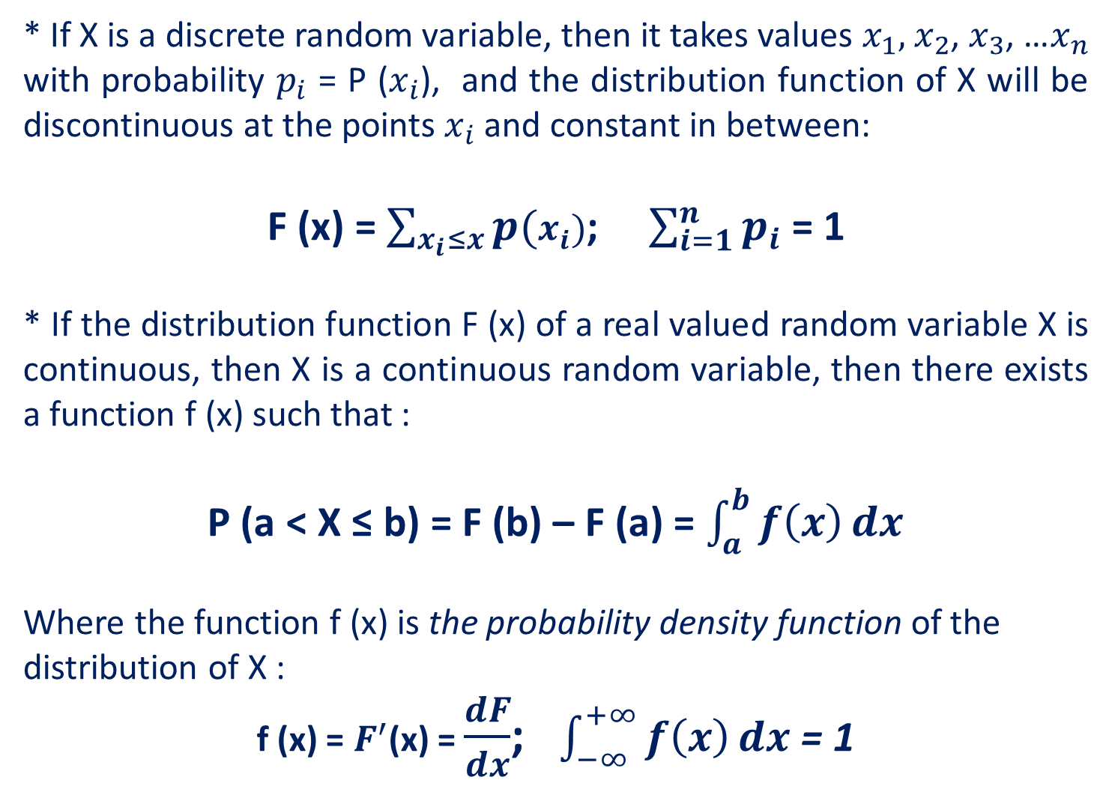
* If X is a discrete random variable, then it takes values $x_{1},$ $x_{2}$, $x_{3}$, …$x_{n}$ with probability $p_{i}$ = P ($x_{i}$), and the distribution function of X will be discontinuous at the points $x_{i}$ and constant in between:
F (x) = $\sum_{x_{i}≤x}{p(x_{i})}$; $\sum_{i=1}^{n}{p_{i}}$ = 1
* If the distribution function F (x) of a real valued random variable X is continuous, then X is a continuous random variable, then there exists a function f (x) such that :
P (a < X ≤ b) = F (b) – F (a) = $\int_{a}^{b}{f\left(x\right)}dx$
Where the function f (x) is the probability density function of the distribution of X :
f (x) = $F^{′}$(x) = $\frac{dF}{dx}$; $\int_{−∞}^{+∞}{f\left(x\right)}dx$ = 1

Slide 26
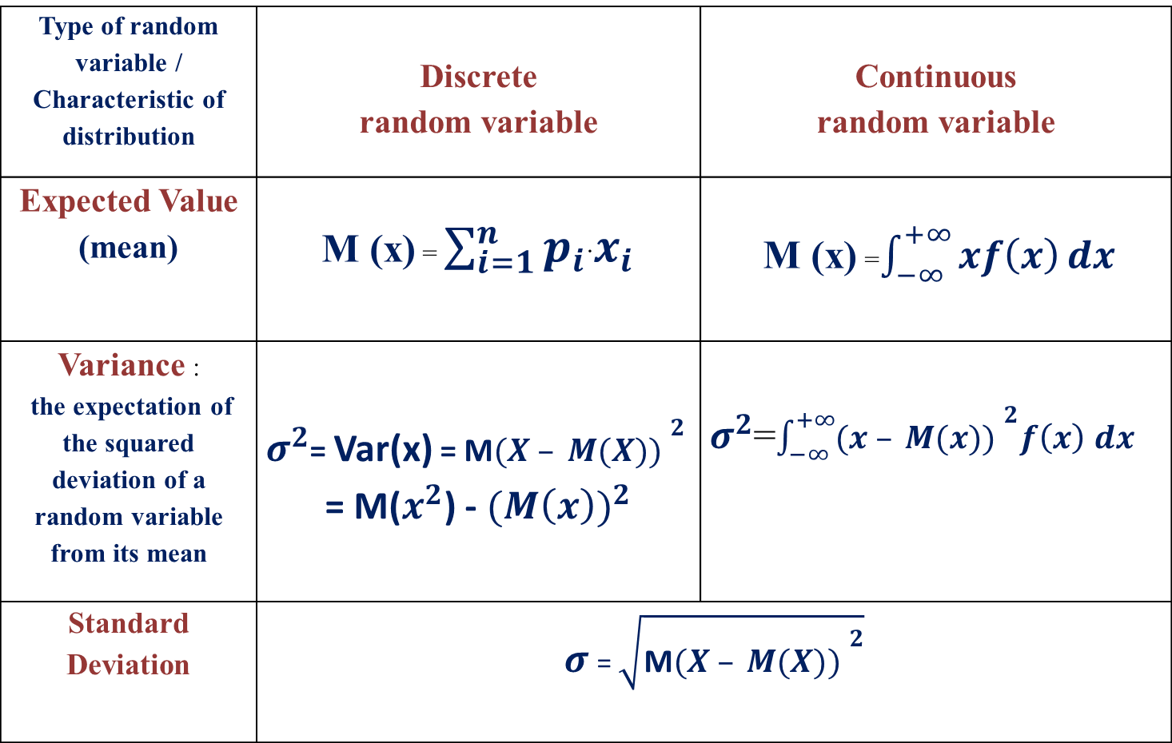
Numerical Characteristics of a distribution
Type of random variable / Characteristic of distribution | Discrete random variable | Continuous random variable
Expected Value (mean) | M (x) = $\sum_{i=1}^{n}{p_{i}}$·$x_{i}$ | M (x) =$\int_{−∞}^{+∞}{xf\left(x\right)}dx$
Variance : the expectation of the squared deviation of a random variable from its mean | $σ^{2}$= Var(x) = M${(X – M(X)) }^{2}$ = M($x^{2}$) - ${(M\left(x\right))}^{2}$ | $σ^{2}$=$\int_{−∞}^{+∞}{{(x – M(x)) }^{2}f\left(x\right)}$ $dx$
Standard Deviation | $σ$ = $\sqrt{\text{M}{(X – M(X)) }^{2}}$

Slide 27
Type of random variable / Characteristic of distribution | Discrete random variable | Continuous random variable
Median | The median is the value of the random variable separating the higher half from the lower half of a data sample (a population or a probability distribution).
Mode | The mode is the value of the random variable probability of which takes its maximum value.

Slide 28
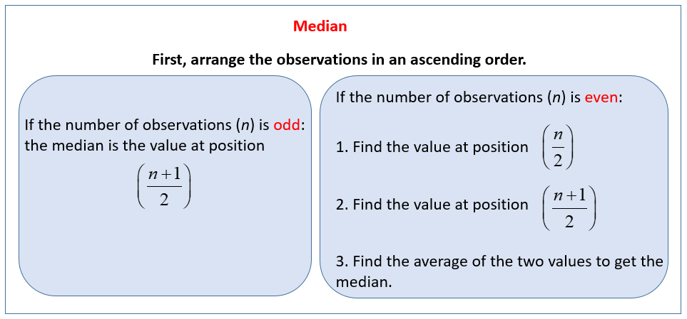
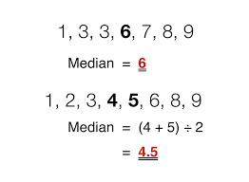

Slide 29
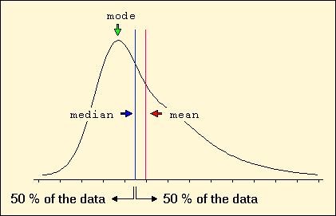
Students age | 16; 17; 17; 17; 18; 18; 19; 20; 25; 33
Mean | 20
Median | 18
Mode | 17

Slide 30
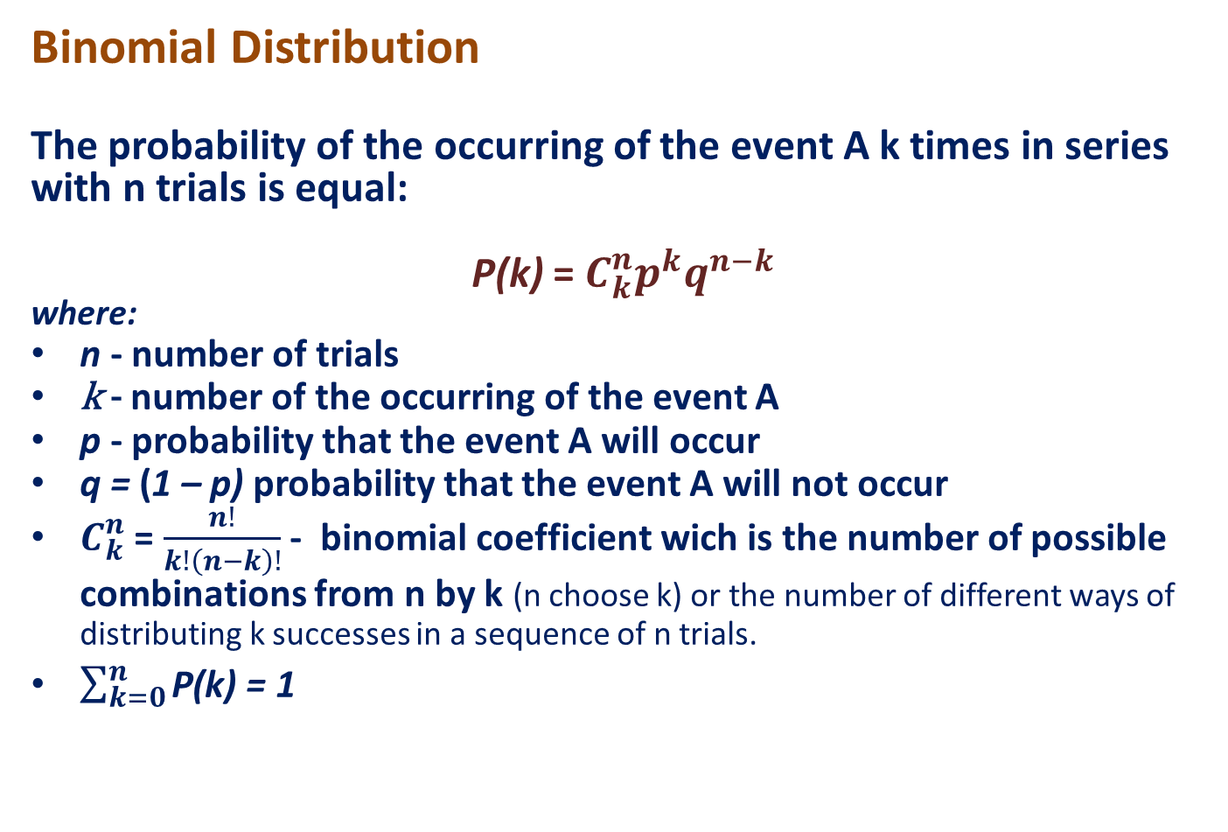
The most important distributions
Binomial Distribution
The probability of the occurring of the event A k times in series with n trials is equal:
P(k) = $C_{k}^{n}p^{k}q^{n−k}$
where:
n - number of trials
k - number of the occurring of the event A
p - probability that the event A will occur
q = (1 – p) probability that the event A will not occur
$C_{k}^{n}$ = $\frac{n!}{k!\left(n−k\right)!}$ - binomial coefficient wich is the number of possible combinations from n by k (n choose k) or the number of different ways of distributing k successes in a sequence of n trials.
$\sum_{k=0}^{n}{\text{P}\text{(}\text{k}\text{)}}$ = 1

Slide 31
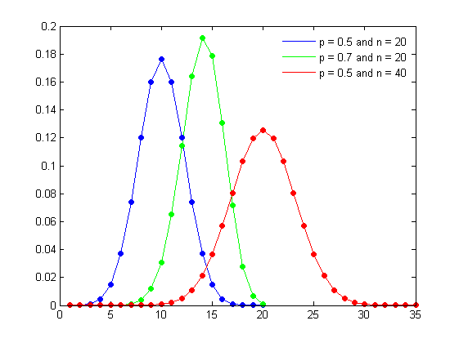
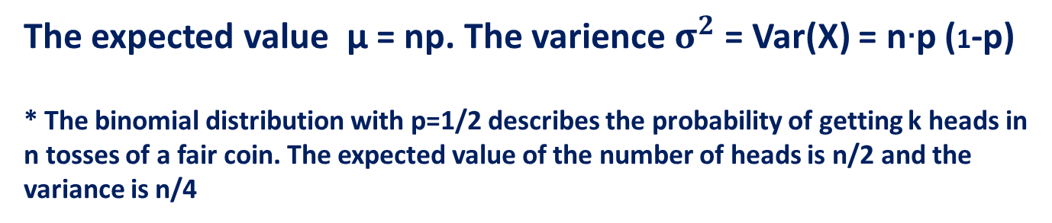
The expected value μ = np. The varience $σ^{2}$ = Var(X) = n$∙$p (1-p)
* The binomial distribution with p=1/2 describes the probability of getting k heads in n tosses of a fair coin. The expected value of the number of heads is n/2 and the variance is n/4

Slide 32
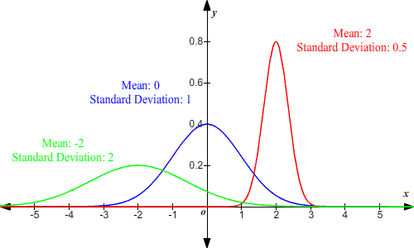

Normal Distribution
y (x, μ, $σ^{2}$ ) = $\frac{1}{σ\sqrt{2π} }{e }^{\text{− }\frac{{(x −μ)}^{2} }{2σ^{2}}}$
Mean = Mode = Median

Slide 33
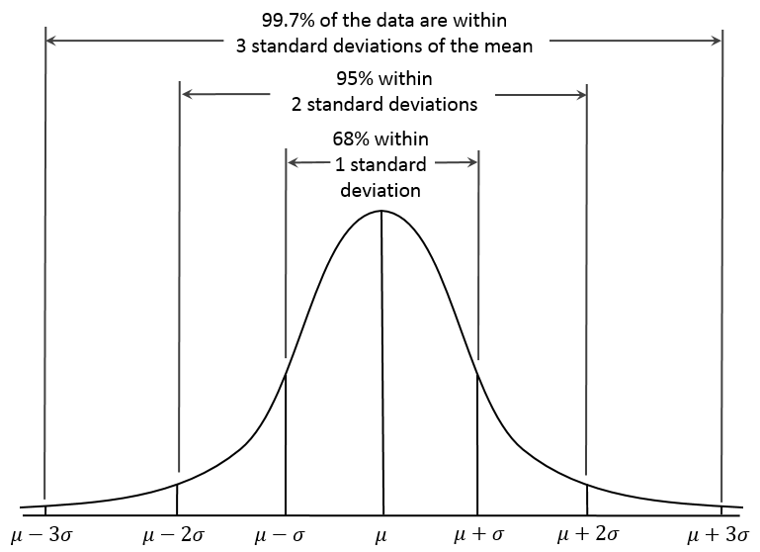
For the normal distribution, the values less than one standard deviation away from the mean account for 68.27% of the set; while two standard deviations from the mean account for 95.45%; and three standard deviations account for 99.73%

Slide 34
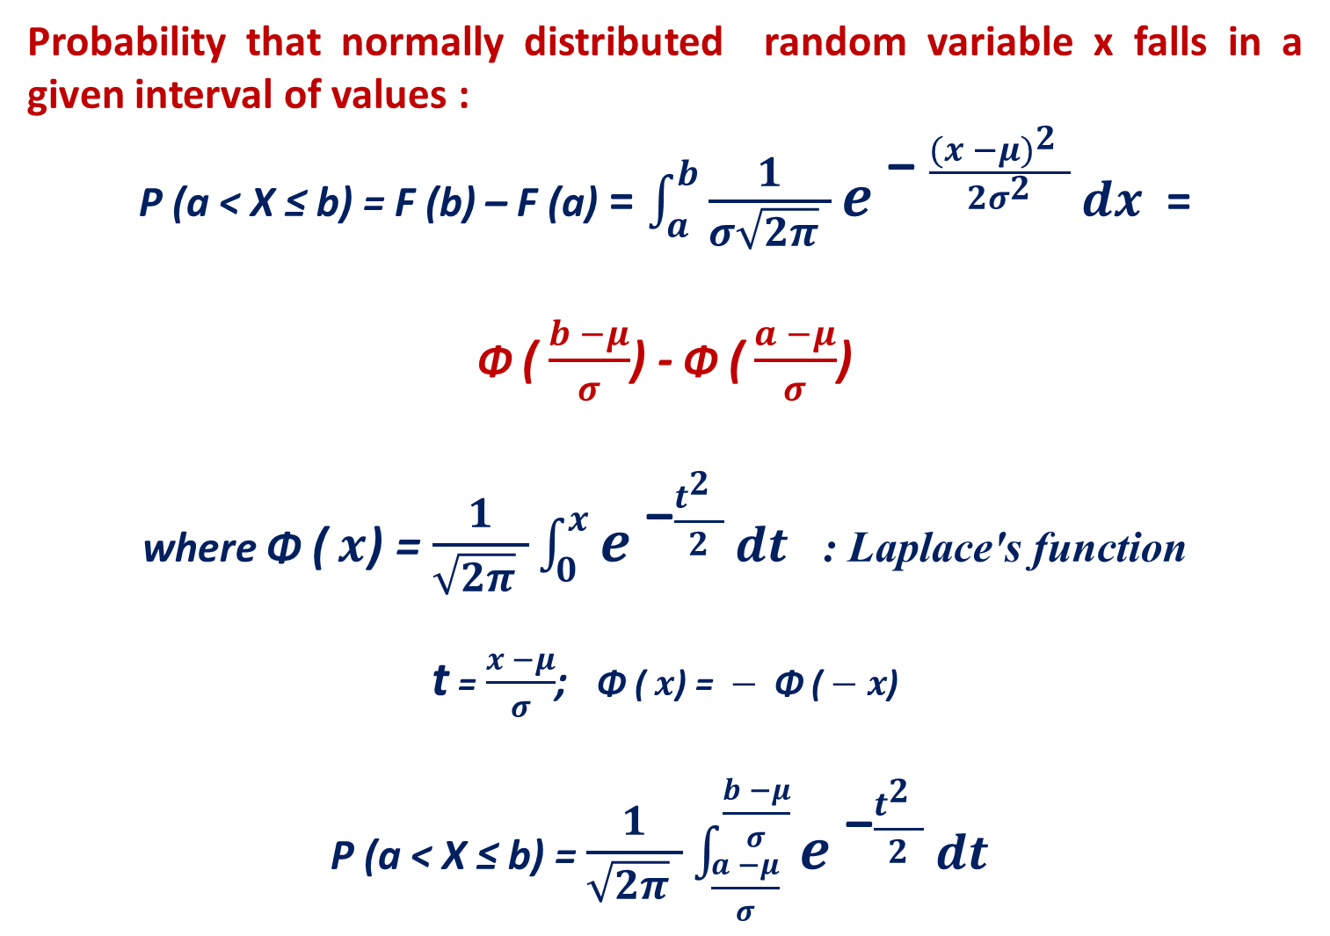
Probability that normally distributed random variable x falls in a given interval of values :
P (a < X ≤ b) = F (b) – F (a) = $\int_{a}^{b}{\frac{1}{σ\sqrt{2π} }{e }^{\text{− }\frac{{(x −μ)}^{2} }{2σ^{2}}}}dx$=
Φ ( $\frac{b −μ}{σ}$) - Φ ( $\frac{a −μ}{σ}$)
where Φ ( $x$) = $\frac{1}{\sqrt{2π} }\int_{0 }^{x}{{e }^{\text{−}\frac{t^{2} }{2}}}dt$ : Laplace's function
t = $\frac{x −μ}{σ}$; Φ ( $x$) = $−$ Φ ( $− x$)
P (a < X ≤ b) = $\frac{1}{\sqrt{2π} }\int_{\frac{a −μ}{σ} }^{\frac{b −μ}{σ}}{{e }^{\text{−}\frac{t^{2} }{2}}}dt$

Slide 35
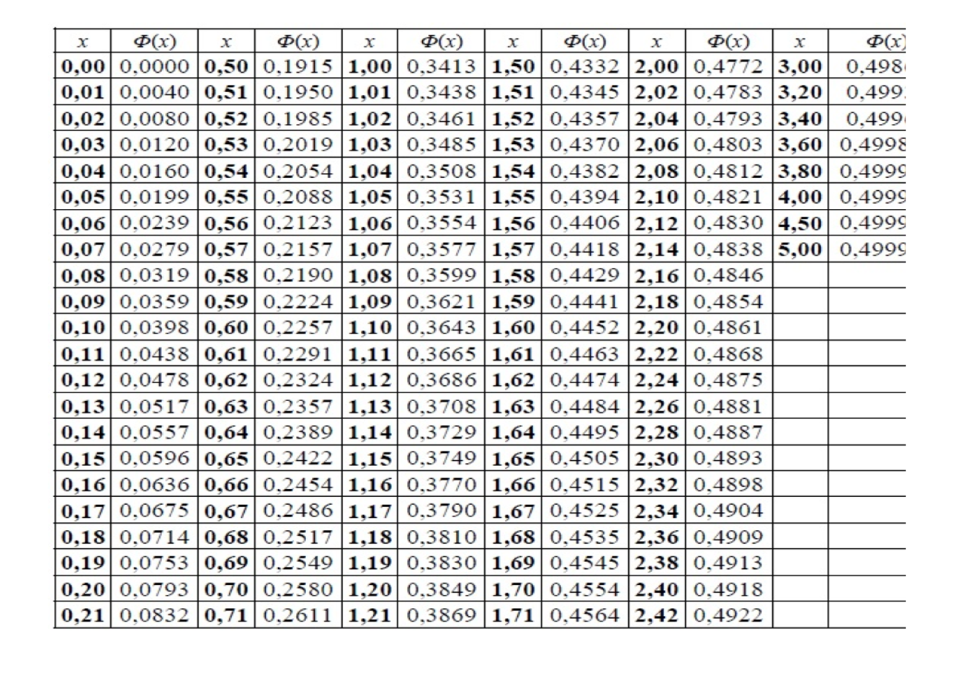

Slide 36
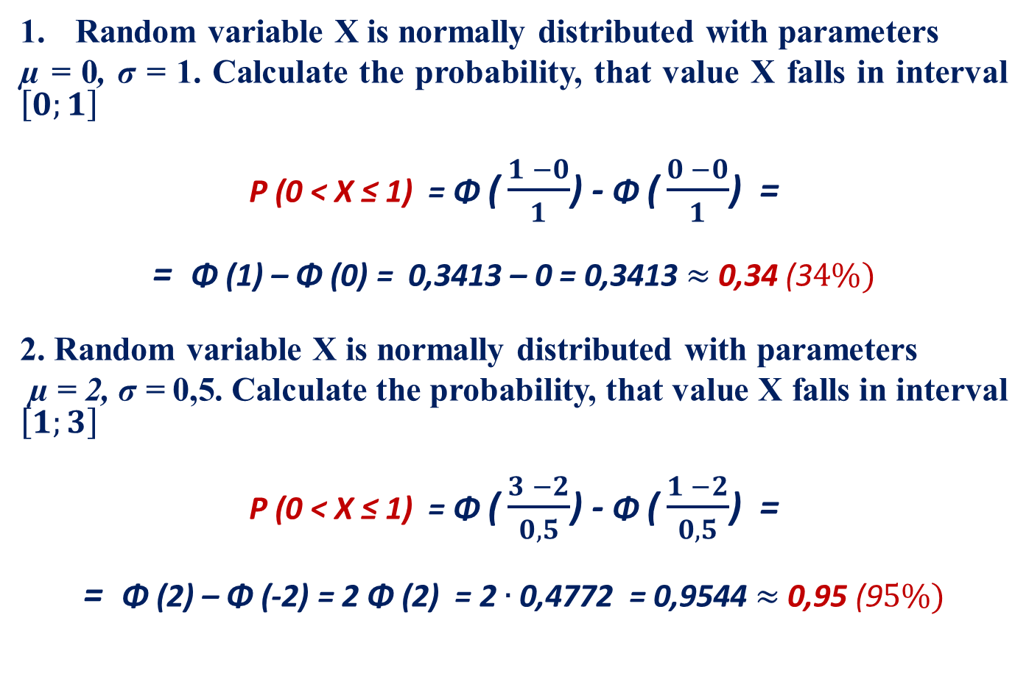
Example
Random variable X is normally distributed with parameters
µ = 0, σ = 1. Calculate the probability, that value X falls in interval $\left[0;1\right]$
P (0 < X ≤ 1) = Φ ( $\frac{1 −0}{1}$) - Φ ( $\frac{0 −0}{1}$) =
= Φ (1) – Φ (0) = 0,3413 – 0 = 0,3413 $≈$0,34 (3$4\%)$
2. Random variable X is normally distributed with parameters
µ = 2, σ = 0,5. Calculate the probability, that value X falls in interval $\left[1;3\right]$
P (0 < X ≤ 1) = Φ ( $\frac{3 −2}{0,5}$) - Φ ( $\frac{1 −2}{0,5}$) =
= Φ (2) – Φ (-2) = 2 Φ (2) = 2 $∙$0,4772 = 0,9544 $≈$0,95 (9$5\%)$

Slide 37
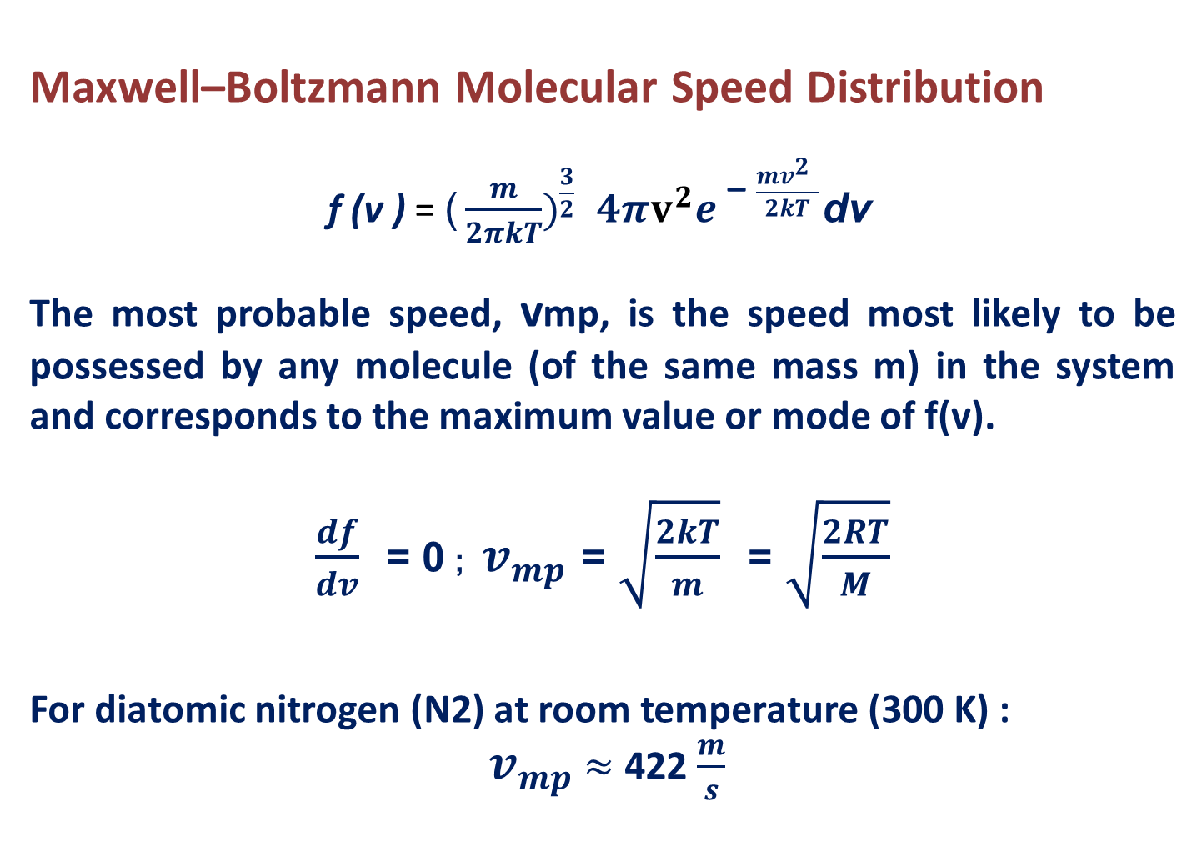
Maxwell–Boltzmann Molecular Speed Distribution
f (v ) ${\text{= }\text{(}\frac{m}{2πkT})}^{\frac{3}{2}} 4πv^{2}{e }^{\text{− }\frac{{mv}^{2} }{2kT}}$dv
The most probable speed, vmp, is the speed most likely to be possessed by any molecule (of the same mass m) in the system and corresponds to the maximum value or mode of f(v).
$\frac{df}{dv}$ = 0 ; $v_{mp}$ = $\sqrt{\frac{2kT}{m}}$ = $\sqrt{\frac{2RT}{M}}$
For diatomic nitrogen (N2) at room temperature (300 K) :
$v_{mp}$ $≈$ 422 $\frac{m}{s}$

Slide 38
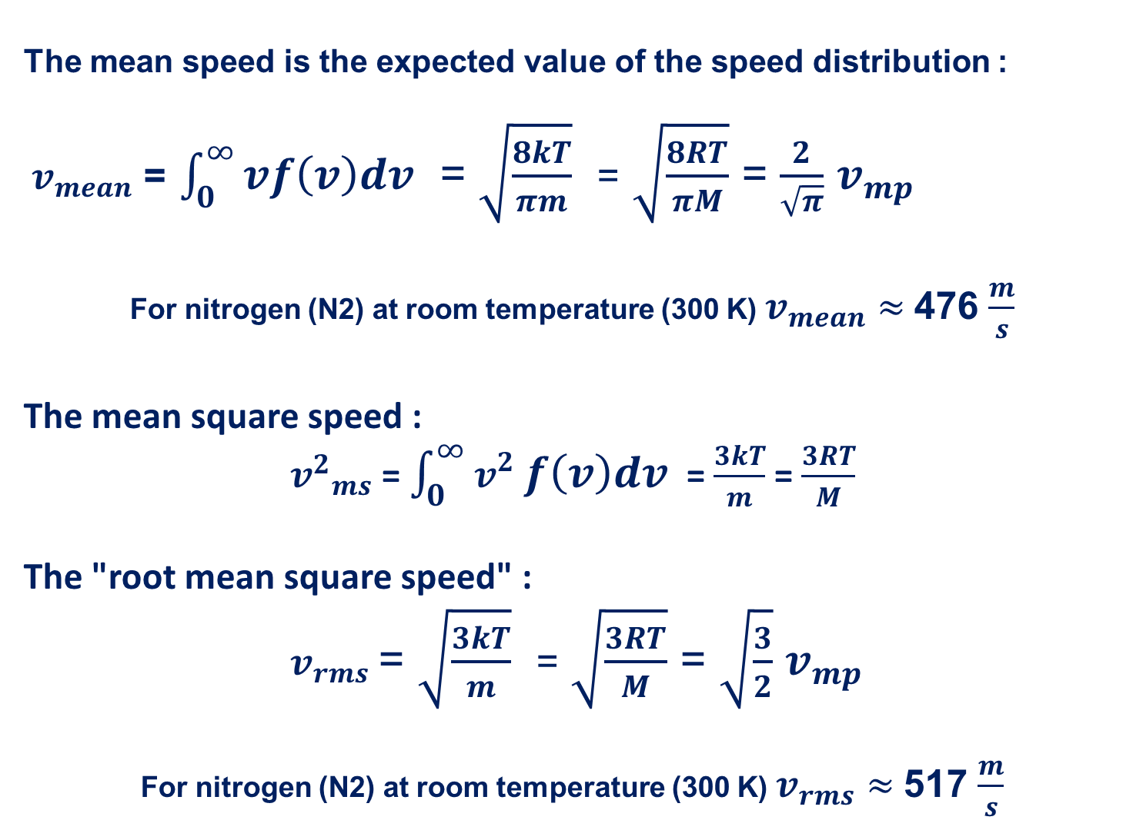
The mean speed is the expected value of the speed distribution :
$v_{mean}$ = $\int_{0}^{∞}{vf\left(v\right)dv}$ = $\sqrt{\frac{8kT}{πm}}$ = $\sqrt{\frac{8RT}{πM}}$ = $\frac{2}{\sqrt{π}}$ $v_{mp}$
For nitrogen (N2) at room temperature (300 K) $v_{mean}$ $≈$476 $\frac{m}{s}$
The mean square speed :
${v^{2}}_{ms}$ = $\int_{0}^{∞}{v^{2} f\left(v\right)dv}$ = $\frac{3kT}{m}$ = $\frac{3RT}{M}$
The "root mean square speed" :
$v_{rms}$ = $\sqrt{\frac{3kT}{m}}$ = $\sqrt{\frac{3RT}{M}}$ = $\sqrt{\frac{3}{2}}$ $v_{mp}$
For nitrogen (N2) at room temperature (300 K) $v_{rms}$ $≈$517 $\frac{m}{s}$

Slide 39
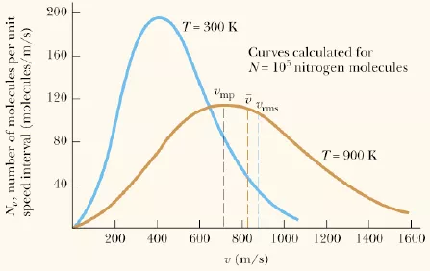

Slide 40
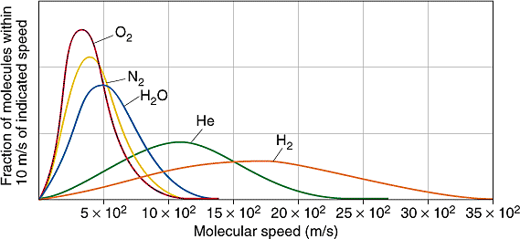

Slide 42
References
1.Medical and Biological Physics. Part І / [ V.I. Fediv, O.I. Olar, O.Y. Mykytiuk and others]. Textbook for students of higher medical education institutions – Chernivtsi: BSMU Publishing House, 2016. - 205 p.
2. Internet resources:
https://en.wikipedia.org/wiki/Normal_distribution
https://en.wikipedia.org/wiki/Binomial_distribution
https://opentextbc.ca/universityphysicsv2openstax/chapter/distribution-of-molecular-speeds/
https://chem.libretexts.org/Bookshelves/Physical_and_Theoretical_Chemistry_Textbook_Maps/Physical_Chemistry_(McQuarrie_and_Simon)/27%3A_The_Kinetic_Theory_of_Gases/27.03%3A_The_Distribution_of_Molecular_Speeds_is_Given_by_the_Maxwell-Boltzmann_Distribution

