Slide 1

Biophysics of membrane processes

Slide 2
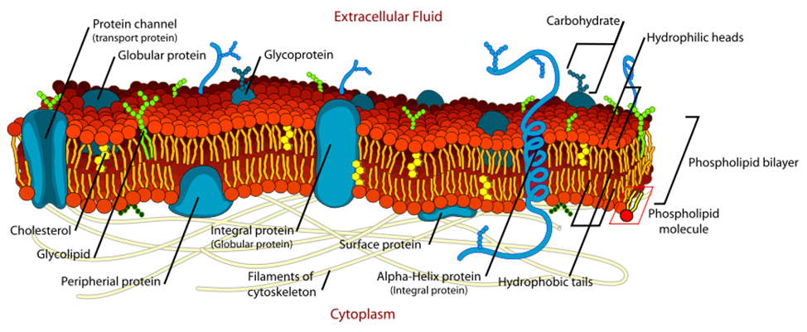
The structure of a cell membrane

Slide 3
Functions of a cell membrane
A cell membrane:
1. Serves as a selectively permeable barrier between two predominantly aqueous compartments
2. Allows compartmentalization of various structures in the cell
3. Enables the formation of a stable and fluid medium for reactions that are catalyzed
4. Provides a flexible boundary between the cell or organelle and its surrounding medium
5. Maintains an electric potential difference
6. Participates in signal transmission to the actin cytoskeleton via integrins
7. Provides adhesion forces to attach cells to their substrates (controlled by
membrane elasticity).
8. Enables mass transport via ion channels

Slide 4
1. Passive transport. Diffusion.
Passive transport is a movement of ions and other atomic or molecular substances across cell membranes without need of energy input.
1.1. Diffusion of uncharged particles. The Fick’s laws.
Diffusion is the net movement of particle of a substance (molecules, atoms, ions, etc.) from a region of high concentration (or high chemical potential) to a region of low concentration (or low chemical potential): the movement of a substance down a concentration gradient.

Slide 5

1.1.1. The Fick’s law (Fick’s first law) states:
- the diffusion flow is directly proportional to the gradient of particles concentration taken with the minus sign, or
- the flow goes from regions of high concentration to regions of low concentration across a concentration gradient; or
- the rate of diffusion per unit area in a direction perpendicular to the area is proportional to the gradient of concentration of solute in that direction:
$j_{n}$ = − D$\frac{dc}{dx}$
where :
$j_{n}$ = $\frac{n}{St}$ - diffusion flow is the number of particles passing through the unit of an area per unit of time;
D is the diffusion coefficient or diffusivity.

Slide 6

In fluids the following (Einstein) formula holds:
D = k$∙$T$∙μ$
where :
k = 1.38 $∙$ ${10}^{−23}$ $\frac{J}{K}$ - is Boltzmann's constant, T is the absolute temperature, $μ$ is the mobility of the particles ($μ$ = $\frac{1}{6πrη}$ - for the sphere-shaped particles)

Slide 7

The diffusion flow can be expressed through the concentration rate as the total amount of the substance is conserved: $\frac{∂j_{n} }{∂x}$ = $−\frac{∂c}{∂t}$ (the flow exists due to the change in concentration with time). Then, it is true that:
$\frac{∂c}{∂t}$ = D $∙$ $\frac{∂^{2}c}{∂x^{2}}$
diffusion equation or Fick's second law.
The partial solution of the diffusion equation is:
c (x, t) = $\frac{1}{\sqrt{4πDt}}$ $∙$ $e^{−\frac{x^{2}}{4Dt}}$

Slide 8
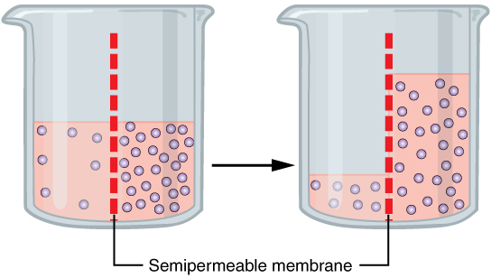
1.1.2. Osmosis. Osmotic pressure.
Osmosis is the transport of molecules in a fluid through a semipermeable membrane due to an imbalance in its concentration on either side of the membrane. Osmosis may be by diffusion, but it may also be a bulk flow through pores in a membrane.

Slide 9

Osmotic pressure is defined as the external pressure required to be applied so that there is no net movement of solvent across the membrane.
𝞹 = c RT
𝞹 is the osmotic pressure;
c = $\frac{n}{V}$ is the molar concentration of a dissolved substance;
R = 8.314 $\frac{J}{molK}$ is the Gas constant;
T is the absolute temperature (in Kelvin)

Slide 10

1.2 Diffusion of the charged particles.
1.2.1 Electric current.
An electric current is a flow of electric charge. Current density is the electric current per unit area of cross section. The current density or the charge flow is defined to be:
$j_{e}$ = $\frac{dq}{Sdt}$ = $\frac{nq_{0}}{Sdt}$; n = c$∙$dV = c $∙$S$∙$dl; $j_{e}$ = $\frac{q_{0}cSdl}{Sdt}$= $q_{0}∙$c$∙$v
where: v is the drift velocity, c – the concentration of the charge carriers, $q_{0}$ – the charge of one particle (ion) which is equal to: $q_{0}$ = e$∙$ z, e =1.6×10⁻¹⁹ coulombs is an elementary charge, z is the valence.

Slide 11

The drift velocity is:
v =$μ_{e}∙E$ = $μ_{e}∙\frac{dφ}{dx}$
where:
E is the magnitude of the applied electric field;
$μ_{e}$- is the electrical mobility - is the ability of charged particles to move through a medium in response to an electric field that is pulling them;
$φ$is the electric potential.

Slide 12

Due to the Einstein relation and definition of mobility:
$μ_{e}$ = $q_{0}∙μ$ = $\frac{q_{0}}{kT}$ $∙$ D
where D is the particles’ (species') diffusion coefficient.
Then:
$j_{e}$ = $q_{0}∙$c$∙μ_{e}∙E$ = ̶ $q_{0}∙$c$∙μ_{e}∙\frac{dφ}{dx}$ = ̶ c $∙$ $\frac{q_{0}^{2}}{kT}∙$D$∙\frac{dφ}{dx}$

Slide 13

1.2.2. Electro-diffusion
The electro-diffusion is a diffusion of electrically charged particles (ions, protons, ions, etc.). This is the process of the flux of ions under the influence of both an ionic concentration gradient $\frac{dc}{dx}$ and an electric field E = − $\frac{dφ}{dx}$ .
The electro-diffusion in a fluid medium can be described by Nernst–Planck equation which is thought to be extended the Fick's law of diffusion for the case where the diffusing particles are also moved with respect to the fluid by electrostatic forces:
$\frac{∂c}{∂t}$ = ̶ $\frac{∂}{∂x}$ ( ̶ D$∙$ $\frac{∂c}{∂x}$ ̶ D $∙c∙\frac{ze}{kT}∙$ $\frac{∂φ}{∂x}$ ) = ̶ $\frac{∂}{∂x}$ J

Slide 14

Where:
J = $j_{n}$ + ${\frac{1}{ze}j}_{e}$ = ̶ D$∙$ $\frac{∂c}{∂x}$ ̶ D $∙c∙\frac{ze}{kT}∙$ $\frac{∂φ}{∂x}$- the particles (chemical species)
flow caused by diffusion force and electrostatic force;
c is the concentration of the species;
D is the diffusivity of the species;
$φ$is the electric potential.

Slide 15

The ionic flow can be expressed also like:
J = ̶ D$∙(\frac{∂c}{∂x}$ + $c∙\frac{zF}{RT}∙$ $\frac{∂φ}{∂x}$) = ̶ $\frac{RT}{zF}∙μ_{e}∙(\frac{∂c}{∂x}$ + $c∙\frac{zF}{RT}∙$ $\frac{∂φ}{∂x}$)
where:
R = k NA = 8.314 $\frac{J}{molK}$ is the Gas constant;
NA = 6.022 $∙$ ${10}^{23}$ $\frac{1}{mol}$ is Avogadro's number;
F = e$∙$NA = 9.648 $∙{10}^{4}$ $\frac{C}{mol}$ is Faraday constant;
$μ_{e}$ – the ionic (electrophoretic) mobility.
The given equation is also known as Nernst–Planck equation.

Slide 16
1.2.3. Transmembrane potential is the difference in electric potential between the interior and the exterior of a biological cell.
A cell membrane is thought to be semipermeable for a certain kinds of ions presented in cytoplasm and in extracellular fluid. The selective permeability of membranes is due largely to ion channels, proteins that allow only certain kinds of ions to cross the membrane in the direction of their concentration decrease (against their concentration gradients).
The ionic concentration difference (gradient) existed inside and outside the cell results in electric potential difference (gradient) across the cell membrane such that the transmembrane voltage exactly opposes the force of diffusion of the ions. In other words it is reached the electrochemical equilibrium at which the diffusive force equals the electromotive force such that the net current of the ion across the membrane is zero and unchanging.

Slide 17
Cellular ion concentrations (millimolar)
Ion | Mammal |  | Squid axon
 | Cell | Blood | Cell | Blood
K⁺ | 100 - 140 | 4-5 | 400 | 10 - 20
Na⁺ | 5-15 | 145 | 50 | 440
Mg²⁺ | 10 0.5 - 0.8 | 1 - 1.5
Ca²⁺ | 10⁻⁴ | 2.2 - 2.6 1.3 - 1.5 | 10⁻⁴ - 3×10⁻⁴ | 10
Cl⁻ | 4 | 110 | 40 - 150 | 560
X⁻ | 138 | 9 | 300 - 400 | 5-10
HCO₃⁻ | 12 | 29
pH | 7.1 - 7.3 | 7.35 to 7.45 (normal arterial blood pH) 6.9 - 7.8 (overall range)

Slide 18

The electrochemical equilibrium can be described with the help of Nernst–Planck equation under the condition that the ionic concentration holds constant and the total ionic current across the membrane is zero:
$\frac{∂c}{∂t}$ = 0, J = $j_{n}$ + ${\frac{1}{ze}j}_{e}$ = 0
This means that: D$∙$ $\frac{∂c}{∂x}$ + D $∙\frac{ze}{kT}∙$ $\frac{∂φ}{∂x}$ =0,
which in turn leads to the Nernst equation:
$E_{m}$ = $φ_{i }$ ̶ $φ_{o}$ = $\frac{kT}{ze}$ ln $\frac{c_{o}}{c_{i}}$ = $\frac{RT}{zF}$ ln $\frac{c_{o}}{c_{i}}$ ,
or with the use of decimal logarithm:
$E_{m}$ = 2.303$∙$ $\frac{RT}{zF}$ lg $\frac{c_{o}}{c_{i}}$
Where $E_{m}$ is the membrane potential (potential difference, voltage)

Slide 19
The Nernst equation describes the relation between ion concentrations and the membrane potential, when only one type of ion can move through the membrane.
Example
Consider a system in which an imaginary membrane separates two compartments containing solutions of ions. Suppose that: 1) both compartments contain a certain amount of potassium ions (K+) and an equal amount of chloride ions (Cl −), such that both compartments are electrically neutral; 2) the membrane is permeable only to potassium ions. An electrochemical equilibrium will be reached when the diffusive force equals the electromotive force.

Slide 21

(A-B): Electrochemical equilibrium due to selective permeability to K+ ions. Concentration gradient drives K+ ions to the right establishing a charge difference. In equilibrium the ionic current due to the concentration difference balances the current in the reverse direction due to the electrical potential difference.
Due to the Nernst equation:
V ($E_{m}$)=$φ_{i }$ ̶ $φ_{o}$ = $\frac{RT}{zF}$ ln $\frac{{[K+]}_{o}}{{[K+]}_{i}}$ = 2.303$∙$ $\frac{RT}{zF}$ lg $\frac{{[K+]}_{o}}{{[K+]}_{i}}$
Since, z = 1, $\frac{{\left[K^{+}\right]}_{o}}{{{[K}^{+}]}_{i}}$ = 0.1, and 2.3$03∙$ $\frac{RT}{F}$ $≈$ 5.8$∙{10}^{−2}$ V = 58 mV (20$℃)$,
then: V = ̶ 58 mV.

Slide 22
For biological membranes, the K+ concentration is typically much higher inside the cell than outside the cell. A typical ratio is [K+]out / [K+]in = 1 : 10, yielding a Nernst potential of
- 58 mV.
In the living cell there are many types of ions are present in the intra and extracellular medium, each of which has its own permeability.

Slide 23
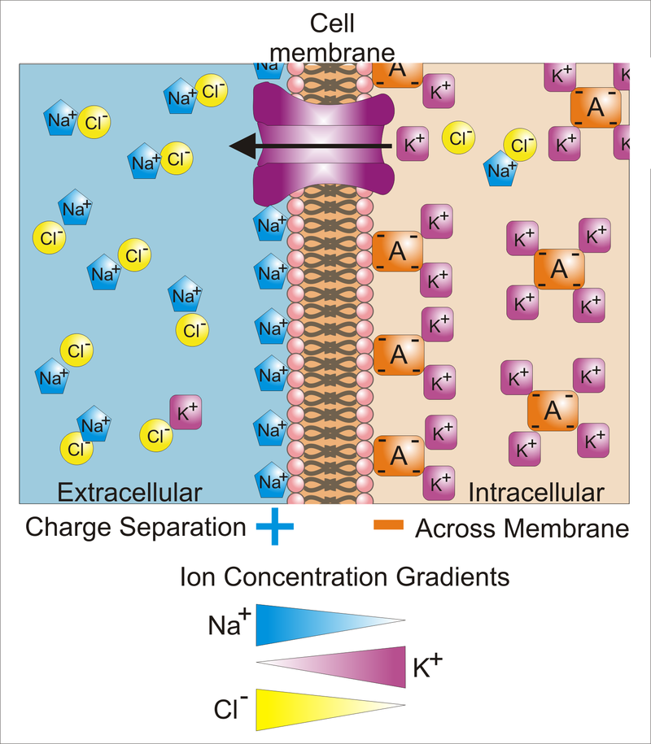

Slide 24

For the case to find the membrane potential accounting the presence of potassium (K+), sodium (Na+), and chloride (Cl−) ions the Nernst equation is transformed in the following form known as the Goldman equation (Goldman–Hodgkin–Katz voltage equation):
$E_{m}$ = $\frac{RT}{F}$ $∙$ln$\frac{P_{Na+}{[Na+]}_{o}+P_{K+}{[K+]}_{o}+P_{Cl−}{[Cl−]}_{i} }{P_{Na+}{[Na+]}_{i}+P_{K+}{[K+]}_{i}+P_{Cl−}{[Cl−]}_{o}}$

Slide 25

Or in more simpler for calculations form:
$E_{m}$ = 58 $∙$log $\frac{P_{Na+}{[Na+]}_{o}+P_{K+}{[K+]}_{o}+P_{Cl−}{[Cl−]}_{i} }{P_{Na+}{[Na+]}_{i}+P_{K+}{[K+]}_{i}+P_{Cl−}{[Cl−]}_{o}}$ (mV)
Where
$E_{m}$ is the membrane potential;
$P_{ion}$ is the permeability for that ion (in meters per second);
${[Ion] }_{i}$ is the intracellular concentration of that ion (in moles per cubic meter);
${[Ion] }_{o}$ is the extracellular concentration of that ion (in moles per cubic meter);

Slide 26
The given equation is used to describing the membrane electric potentials (voltage) such as the reversal potential and the resting membrane potentials when the total ionic flow across the membrane is zero and the electrochemical equilibrium has been reached.
In the case that the membrane is only permeable to one ion, the Goldman equation reduces to the Nernst equation.

Slide 27
References
1.Medical and Biological Physics. Part І / [ V.I. Fediv, O.I. Olar, O.Y. Mykytiuk and others]. Textbook for students of higher medical education institutions – Chernivtsi: BSMU Publishing House, 2016. - 205 p.
2.Medical and Biological Physics. Part ІІ / [ V.I. Fediv, O.I. Olar, O.Y. Mykytiuk, V.F. Boiechko]. Textbook for students of higher medical education institutions – Chernivtsi: BSMU Publishing House, 2017. - 235 p.
3. Jack A. Tuszynski, Michal Kurzynski. Introduction to Molecular Biophysics. CRC Press LLC, 2019.
4.Irving P. Herman. Physics of the Human Body. / Springer – Verlag. Berlin, Heidelberg 2007.
5. Internet resources:
https://commons.wikimedia.org/wiki/File:Cell_membrane_detailed_diagram_en.svg
https://en.wikipedia.org/wiki/Osmosis
https://en.wikipedia.org/wiki/Membrane_potential
https://en.wikipedia.org/wiki/Electrochemical_gradient

