Slide 1

Action Potential
Generation and Propagation

Slide 2
The objects of consideration:
Excitable cells - are cells membrane of which can change its electric potential difference (membrane voltage) in response to applied stimulus.
Excitable cells can generate an action potential at its membrane in response to depolarization and may transmit an electrical impulse – a wave of depolarization along the membrane.
Excitable cells: neurons, muscle cells, endocrine cells (e.g. insulin-releasing pancreatic β cells)

Slide 3
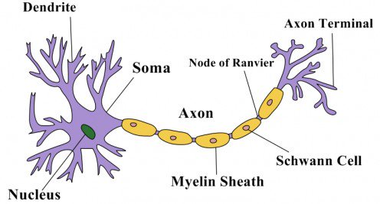
A neuron or nerve cell - is an electrically excitable cell that receives, processes and transmits information through electrical and chemical signals.

Slide 4
• dendrites: receive signals from neighboring neurons
• axon: transmit signals over a distance
• axon terminal: transmit signals to other neuron dendrites or tissues
• myelin sheath: insulator which speeds up signal transmission along the axon
• nodes of Ranvier: myelin-sheath gaps where the axolemma is exposed to the extracellular space.

Slide 5
1. Basic notions and definitions

Slide 6
- Membrane potential (transmembrane potential difference, membrane voltage) – is the difference in electric potential between the interior and the exterior of a biological cell.
- Reversal potential (equilibrium potential) – is a potential which is thought to be established across a cell membrane when diffusive and electrical forces counterbalance each other, so that there is no net ion flow across the membrane.
- Resting potential (stationary potential) – is a potential which is being established across a cell membrane (particularly across the excitable cells membrane) at resting (steady) state when no stimuli affect the cell.

Slide 7
- Graded potentials – are changes in membrane potential due to activity of ligand-gated ion channels or some other types-gated canals. The magnitude of a graded potential is determined by the strength of the stimulus. Graded potentials may be excitatory or inhibitory.
• Excitatory postsynaptic potentials (EPSPs) – are potentials which result from the flow of positively charged ions into the postsynaptic cell due to opening ligand-gated ion channels, or from a decrease in positive charge outflow.
EPSPs make a postsynaptic neuron more likely to generate an action potential – increase the likelihood of a postsynaptic action potential occurring.
• Inhibitory postsynaptic potentials (IPSPs) – are potentials which result from the flow of negatively charged ions into the cell due to opening ligand-gated ion channels, or from an increase in positive charge outflow.
IPSPs make a postsynaptic neuron less likely to generate an action potential – decrease the likelihood of a postsynaptic action potential occurring.

Slide 8
- Excitatory postsynaptic current (EPSC) - is the flow of ions that causes an EPSP
- Action Potential (nerve impulse, spike) – a sudden brief shift in membrane potential from negative to positive normally caused by the incoming sodium ions flow
- Action Potential Threshold – is the critical level of membrane potential at which an action potential can be initiated
- Refractoriness – is the property not to respond on stimuli

Slide 9
2. The Key Functional Elements
- Ion channels
- Neurotransmitters
- Sodium-Potassium Pump

Slide 10
1. Ion channels - are integral membrane proteins with a pore through which ions can travel between extracellular space and cell interior
- Leakage channels - are type of ion channels whose permeability is relatively constant and through which passive ion transport (diffusion) occurs
- Gated channels – are an ion channels that open or close in response to stimuli such as neurotransmitters or to a changeling pressure, temperature, voltage, or light

Slide 11
- Mechanically-gated channels (mechanosensitive ion channels, stretch-gated ion channels)
– are channels which open to allow ions to pass through the membrane in response to the mechanical stimuli (pressure, touch, tissues stretching, vibrations/ sound)
- Ligand-gated channels - are channels whose permeability is greatly increased when some type of chemical ligand binds to the protein structure.
Ligand-gated channels are a group of transmembrane ion-channel proteins which open to allow ions such as Na+, K+, Ca2+, and Cl− to pass through the membrane in response to the binding of a chemical messenger (i.e. a ligand), such as a neurotransmitter
- Voltage-gated channels - are channels whose permeability is influenced by the membrane potential difference – membrane voltage (permeability depends on applied electric field)

Slide 12
2. Neurotransmitters
- are endogenous chemicals that enable neurotransmission and which are released by the axon terminal of a neuron
(the presynaptic neuron), and bind to and activate the receptors on the dendrites of another neuron (the postsynaptic neuron)

Slide 13
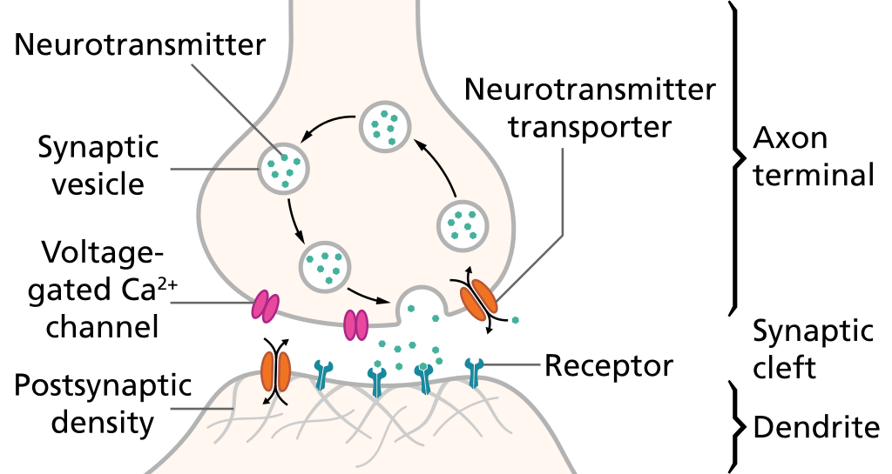

Slide 14
3. Sodium-Potassium Pump
( Na+ / K+ pump, sodium-potassium adenosine triphosphatase Na+ / K+ ATPase )
– is a mechanism that pumps sodium out of cells while pumping potassium into cells to maintain stability of the ions concentration gradients and resting potential

Slide 15
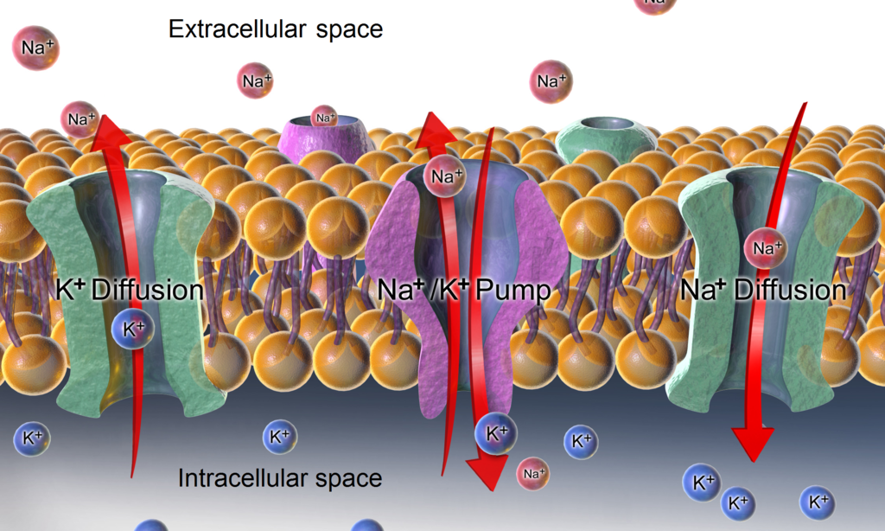

Slide 16
3. Functioning / Mechanism
"All-or-none" principle - action potential can occur fully or does not occur at all

Slide 17
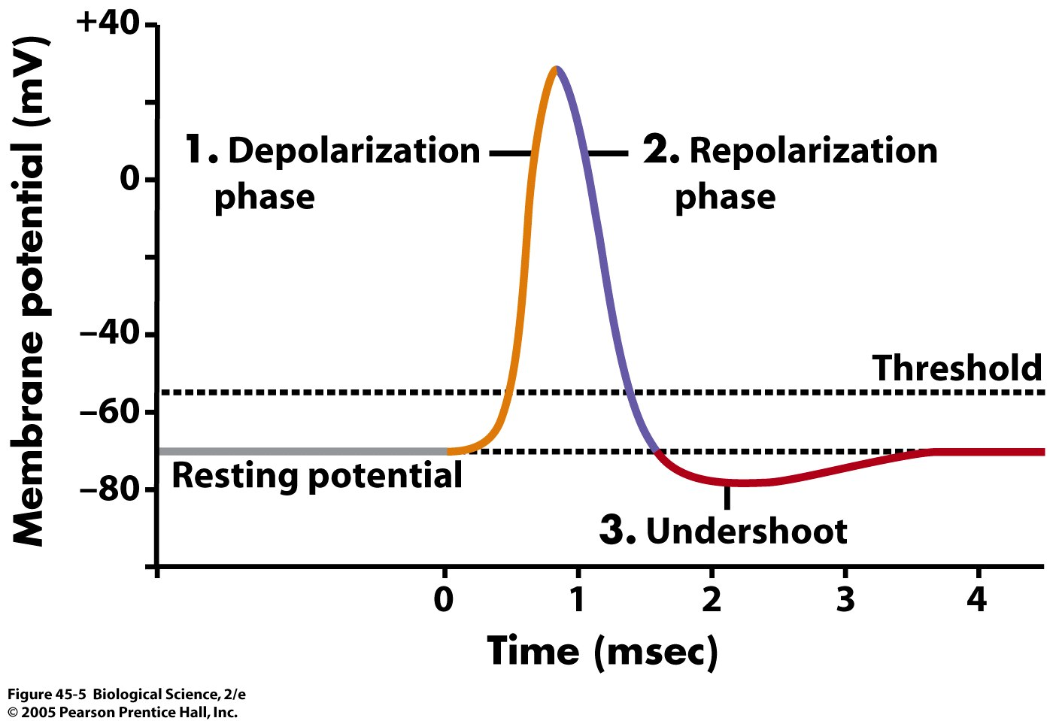

Slide 18
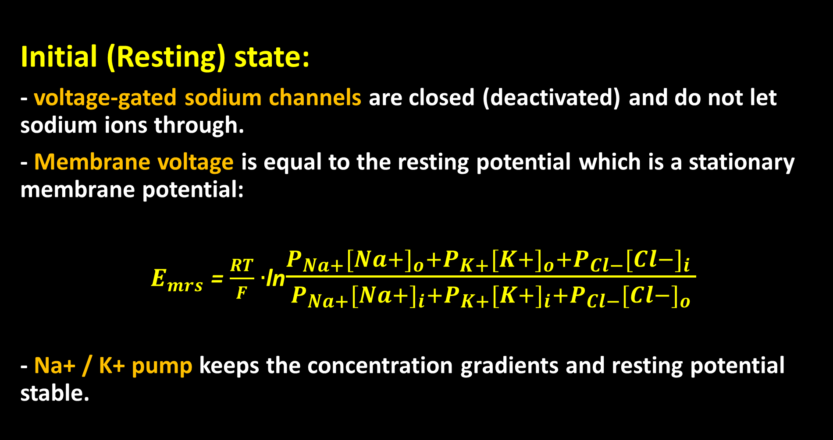
Initial (Resting) state:
- voltage-gated sodium channels are closed (deactivated) and do not let sodium ions through.
- Membrane voltage is equal to the resting potential which is a stationary membrane potential:
$E_{mrs}$ = $\frac{RT}{F}$ $∙$ln$\frac{P_{Na+}{[Na+]}_{o}+P_{K+}{[K+]}_{o}+P_{Cl−}{[Cl−]}_{i} }{P_{Na+}{[Na+]}_{i}+P_{K+}{[K+]}_{i}+P_{Cl−}{[Cl−]}_{o}}$
- Na+ / K+ pump keeps the concentration gradients and resting potential stable.

Slide 19
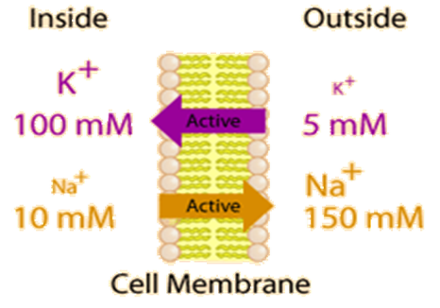

Slide 20
Zero Phase - Initiation:
- Gated channels open in response to stimuli such as neurotransmitters* or pressure, temperature, voltage, light, sound etc. and pass the ions flow through the membrane what in turn causes changes in membrane potentials (causes graded potentials to happen).
* Neurotransmitters that act to open Na+ channels produce excitatory postsynaptic potentials, or EPSPs, whereas neurotransmitters that act to open K+ or Cl− channels produce inhibitory postsynaptic potentials, or IPSPs.
- When multiple types of channels are open within the same time period, the respective graded potentials and potentials due to opening of some voltage-gated sodium channels summate.

Slide 21
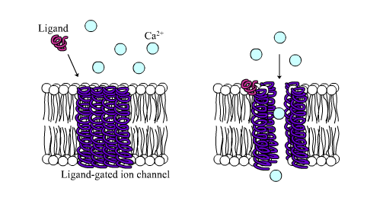

Slide 22
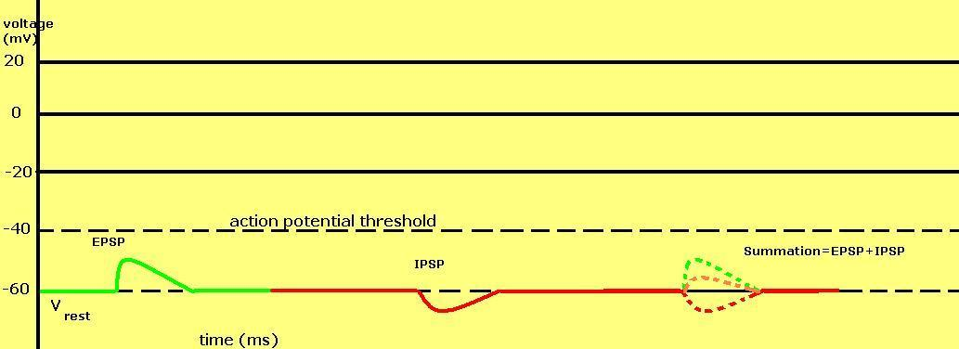

Slide 23
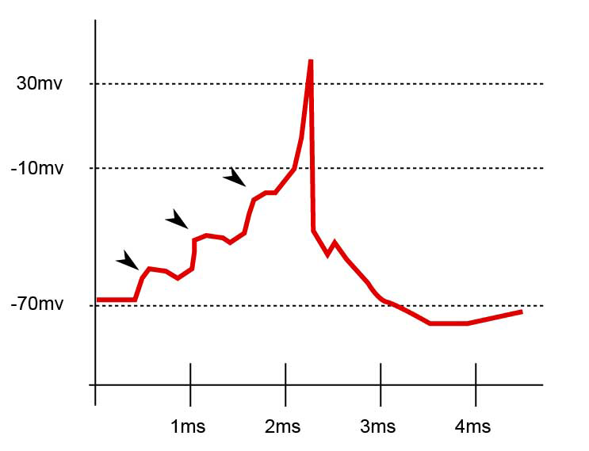

Slide 24

Phase one – Depolarization:
- After the membrane potential reached the activation threshold (-55 mV), a significant amount of voltage-gated sodium channels are open and cause rapid depolarization.
- Once membrane voltage reaches around +30 mV then voltage-gated sodium channels become inactivated (closed) and depolarization stops.
V = $E_{mrs}$ + $\frac{RT}{F}$ ln $\frac{{[Na+]}_{o}}{{[Na+]}_{i}}$

Slide 25
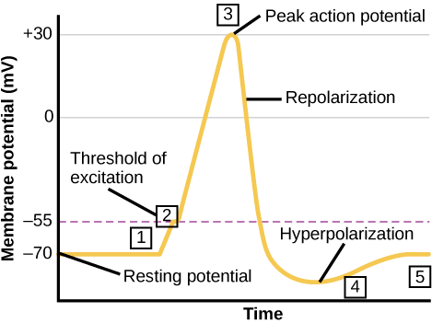

Slide 26
Phase two – Repolarization:
- Voltage-gated potassium channels activate (open)
- Membrane voltage rapidly changes back and overshoots its resting membrane potential (hyperpolarization).
- Hyperpolarization – potassium channels stay open and continue to let potassium ions through.
- Voltage-gated potassium channels inactivate and membrane voltage returns to its resting value (near -70mV).

Slide 27
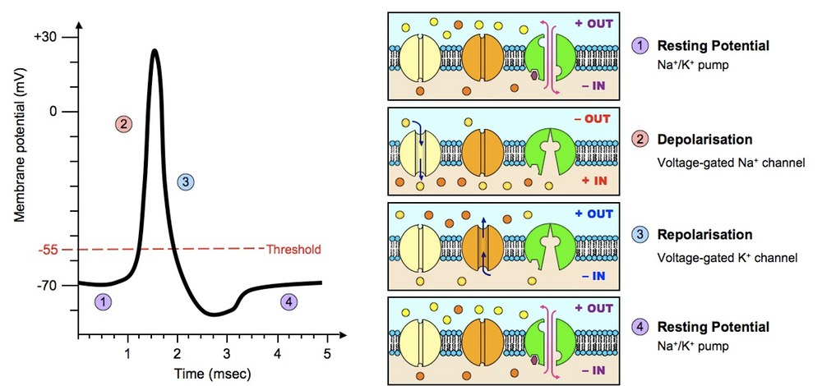

Slide 28
Refractory period -
is a period of time during which a cell can’t be electrically excited regardless of the strength of the stimulus. Refractory period is equal to the amount of time it takes for an excitable membrane to be ready for a next stimulus once it returns to its resting state following an excitation. The refractory period in a neuron occurs after an action potential generated.
- The absolute refractory period – the period while and after depolarization when the majority of sodium channels remain in the inactive state. While the voltage-gated sodium channels are in the inactive state, it will not open in response to depolarization.
- The relative refractory period - the period after depolarization (while hyperpolarization) when partially repolarization has occurred and a greater stimulus is required to cause the action potentials to happen.

Slide 29
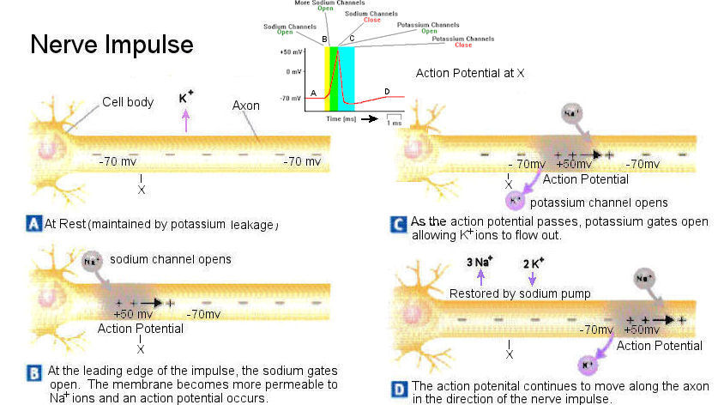

Slide 30
References
1.Medical and Biological Physics. Part І / [ V.I. Fediv, O.I. Olar, O.Y. Mykytiuk and others]. Textbook for students of higher medical education institutions – Chernivtsi: BSMU Publishing House, 2016. - 205 p.
2.Medical and Biological Physics. Part ІІ / [ V.I. Fediv, O.I. Olar, O.Y. Mykytiuk, V.F. Boiechko]. Textbook for students of higher medical education institutions – Chernivtsi: BSMU Publishing House, 2017. - 235 p.
3. Jack A. Tuszynski, Michal Kurzynski. Introduction to Molecular Biophysics. CRC Press LLC, 2019.
4.Irving P. Herman. Physics of the Human Body. / Springer – Verlag. Berlin, Heidelberg 2007.
5. College Physics: OpenStax.
6. Internet resources:
https://en.wikipedia.org/wiki/Action_potential
https://en.wikipedia.org/wiki/Neurotransmitter
https://en.wikipedia.org/wiki/Na%2B/K%2B-ATPase
https://en.wikipedia.org/wiki/Excitatory_postsynaptic_potential
https://en.wikipedia.org/wiki/Inhibitory_postsynaptic_potential
https://en.wikipedia.org/wiki/Ligand-gated_ion_channel
https://pressbooks.bccampus.ca/collegephysics/chapter/electric-forces-in-biology/

