Slide 1


I. Fundamentals of Hydrodynamic
1. Principles of Hydrostatics
1.1. Hydrostatic pressure is the weight of the fluid mg per unit of the area S supporting it (the area of the bottom of the vessel):
P = $\frac{mg}{S}$ = $\frac{ρgV}{S}$ = $ρgh$
hydrostatic pressure due to the weight of a fluid

Slide 2
1.2. Pascal's Principle:
A change in pressure applied to an enclosed fluid is transmitted undiminished to all portions of the fluid and to the walls of the vessel.
1.3. Archimedes’ principle:
The buoyant force on an object equals the weight of the fluid it displaces.

Slide 3

Pressure due to the weight of a fluid increases with depth since P = ρg$h$ . This pressure and associated upward force on the bottom of the cylinder are greater than the downward force on the top of the cylinder.
Their difference is the buoyant force Fb (Horizontal forces cancel)

Slide 4

2. Dynamics of an ideal fluid
2.1. Flow rate Q is defined to be the volume of fluid passing through cross-sectional area of vessel per unit of time:
Q = $\frac{dV}{dt}$= $\frac{Sdl}{dt}$ = S$∙v$
2. 2. The equation of continuity for the steady laminar flow:
$\frac{dm}{dt}$ = $ρ∙v∙S=$const

Slide 5

For incompressible fluid when density $ρ=const$ then
Q =$v∙S=$const or $S_{1}v_{1}$ = $S_{2}v_{2}$
When a flow splits into two currents the sum of flow rates remains constant Q = $Q_{1}$ + $Q_{2}$

Slide 6
2.3. Bernoulli's equation.

Slide 7

When a fluid flows into a narrower channel, its speed increases. That means its kinetic energy also increases. The increased kinetic energy comes from the net work done on the fluid to push it into the channel and the work done on the fluid by the gravitational force, if the fluid changes vertical position.
$\frac{{∆mv}_{2}^{2}}{2}$ - $\frac{{∆mv}_{1}^{2}}{2}$ = $W_{net}$ + ($∆$mg$h_{1}$- $∆$mg$h_{2}$)
$W_{net}$ = ($P_{1}$ - $P_{2}$) S$∙∆l$ = ($P_{1}$ - $P_{2}$)$∙ ∆V$

Slide 8


Where:
P is an absolute inner static pressure
$\frac{{ρv}^{2}}{2}$ - hydrodynamic pressure$,$
𝜌𝑔ℎ - hydrostatic pressure.
$ρ$ is the fluid density
v is the velocity of the fluid
h is the height above some reference point,
g is the acceleration due to gravity
Bernoulli’s equation states that for an incompressible, frictionless fluid
P + $\frac{{ρv}^{2}}{2}$ + $ρgh$ = const

Slide 9
The Bernoulli Equation can be considered to be a statement of the conservation of energy principle appropriate for flowing fluids. Conservation of energy applied to fluid flow produces Bernoulli’s equation.
The net work done by the fluid’s pressure results in changes in the fluid’s kinetic and potential energy per unit volume. If other forms of energy are involved in fluid flow, Bernoulli’s equation can be modified to take these forms into account. Such forms of energy include thermal energy dissipated because of fluid viscosity.

Slide 10
Bernoulli’s Principle—Bernoulli’s Equation at Constant Depth:
The pressure drops as speed increases in a moving fluid. We can see this from Bernoulli’s principle. For example, if v2 is greater than v1 in the equation, then P2 must be less than P1 for the equality to hold.

Slide 11
3. Viscosity of biological fluids
3.1 The viscosity of a fluid is a measure of its resistance to gradual deformation by shear stress. Shear stresses applied to an element of fluid cause a relative movement of the surfaces (layers).
The viscosity of a fluid is determined by how molecules constituting the system interact. A fluid is thought to be ideal if it has zero viscosity.
Viscosity depends on nature of fluids, external conditions (temperature, pressure (for gases)) and type of the flow.

Slide 12
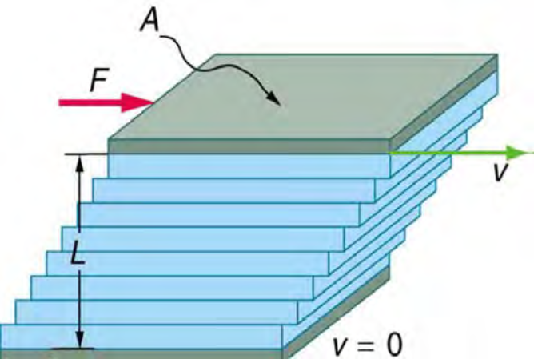
Each successive layer from the top down exerts a force upon the one below it, trying to drag it along, producing a continuous variation in speed from v to 0.
Friction between the fluid and the moving boundaries/plates causes the fluid to shear. The force required for this action is a measure of the fluid's viscosity.
F = η ∙ A∙ 𝝏𝑽/𝝏𝒚
or (𝒔𝒉𝒆𝒂𝒓 𝒔𝒕𝒓𝒆𝒔𝒔)
𝝉 = 𝑭/𝑨 = η ∙ 𝝏𝑽/𝝏𝒚

Slide 13

F = η ∙ A∙ 𝝏𝑽/𝝏𝒚
F is directly proportional to:
1) the area A of the adjacent layers
2) the strain (shear) rate or the rate of shear deformation which is the gradient of velocity of layers in the direction perpendicular to the layers
3) the coefficient of internal friction or viscosity η
The SI units of viscosity are: [η ] = $\frac{N∙s}{m^{2}}$ = Pa$∙$s

Slide 14
3. 2 There exist two types of fluids with respect to viscosity behavior: Newtonian fluids and non-Newtonian fluids
A fluid is thought to be Newtonian if it has a viscosity which is independent of shear rate (applied force or pressure), otherwise the fluid is considered to be a non-Newtonian.
For Newtonian fluids viscosity depends only on temperature
and nature of the fluid.

Slide 15
Data of viscosity in millipascal (mPa)
with respect to temperature in Celsius (t° C)
Temperature t° C | 0 | 20 | 37 | 40 | 100
fluid
Water | 1.792 | 1.002 | 0.6947 | 0.653 | 0.282
Blood plasma |  | 1.810 | 1.257
Whole blood |  | 3.015 | 2.084

Slide 16
3.3 Blood is non-Newtonian fluid:
This means that blood viscosity is depend of shear rate (applied force or pressure) and actually is affected by blood velocity in vessels.
It happens because blood is not a homogeneous fluid, but consists of a suspension of cells and platelets in a fluid solution called plasma with about equal proportions of each.

Slide 17
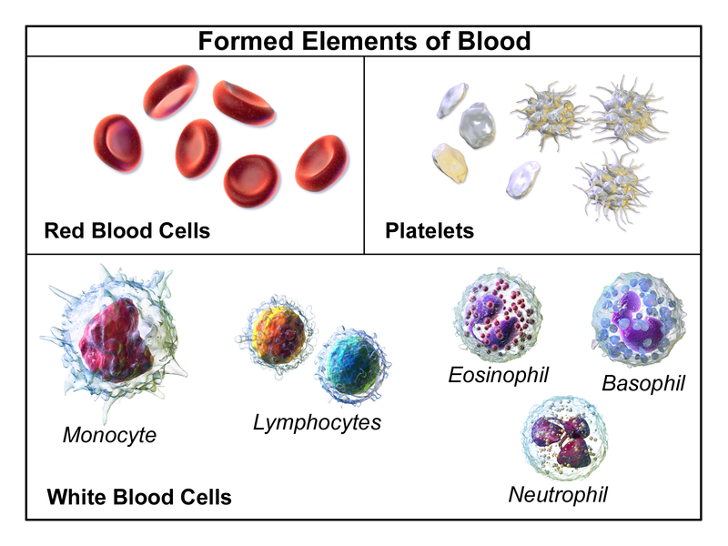

Slide 18

The plasma (colloidal solution with а total concentration of protein of 6-9%) is about 90% water and in isolation behaves as a Newtonian fluid, with a viscosity of 0.0012 Pa$∙$s.
The erythrocytes (Red Blood Cells – RBC) are biconcave discs, essentially toroidal in shape but with the middle filled in. The outer diameter of the torus as 7.5 $μ$m ( ${10}^{−6}m$) and the ring diameter, or cell thickness, as 2 $μ$m. Although these cells are deformable, and are capable of travelling along tubes smaller than their own diameter, the diameter of the red blood cells is about that of the capillaries in the cardiovascular circulation. Adults have about 5 million red blood cells per cubic millimeter of blood.

Slide 19
The leukocytes (White Blood Cells – WBC) are spherical with diameters of about 7 𝜇m, and their major role is in disease-defense mechanisms. Leukocytes make up about 0.3% of the blood volume.
The platelets are fragments of very large parent cells (megakaryocytes), and are much smaller than the red or white cells. They play a key role in clotting processes. The platelets make up about 0.15% of the blood volume.

Slide 20

The percentage of the volume occupied by the red cells is called the hematocrit (the ratio of the volume of red blood cells to the total volume of plasma).
Hct = $\frac{V_{formed elements}}{V_{plasma}}$ $≈$ $\frac{V_{erythrocytes}}{V_{plasma}}$
A typical value of the hematocrit in a healthy individual is about 45%.
The bulk viscosity of the blood is a function of the hematocrit and increases as the hematocrit increases:
η = $η_{0}∙$ ${(1+αHct)}^{β}$ or η = $η_{0}∙e^{γ∙Hct}$
where: η - blood viscosity, $η_{0}$ – viscosity of plasma, $α,β$, $γ$ – are empirical coefficients.

Slide 21

The bulk viscosity of the blood is a function of the hematocrit and increases as the hematocrit increases:
η = $η_{0}∙$ ${(1+αHct)}^{β}$ or η = $η_{0}∙e^{γ∙Hct}$
where: η - blood viscosity, $η_{0}$ – viscosity of plasma,
$α,β$, $γ$ – are empirical coefficients.

Slide 22
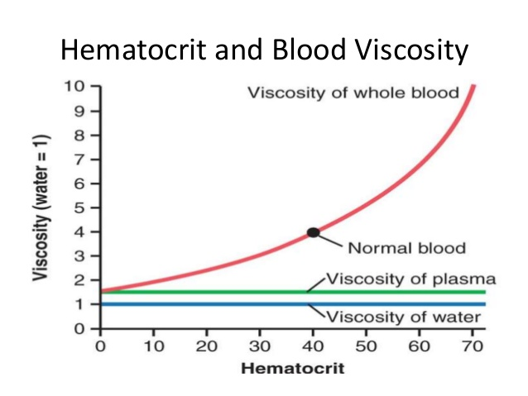

Slide 23
4. Flow of viscous fluid in a tube
4.1 There are two types of fluids flow related to viscosity: the laminar flow and the turbulent flow.
Laminar flow is characterized by the smooth flow of the fluid in layers that do not mix
Turbulent flow, or turbulence, is characterized by eddies and swirls that mix layers of fluid together.

Slide 24

There is a criteria (indicator) called the Reynolds number Re which can reveal whether flow is laminar or turbulent.
For flow in a tube of uniform diameter, the Reynolds number is defined as:
Re = $\frac{ρvd}{η}$
where : $ρ$ - is the density of the fluid; v - is the speed of the fluid; d – is the diameter of the tube; η – is the viscosity of the fluid
The Reynolds number is a unitless quantity. Experiments have revealed that Re is related to the onset of turbulence.

Slide 25

The relationship between the Reynolds number and the characteristics of the flow
$0<$ Re $≤$ 1 | Flow is laminar in form of ‘creeping ‘flow, entirely dominated by viscosity.
$1<$ Re $≤$ 2000 | Laminar flow, determined by fluid viscosity and kinetic energy of flow.
2000 $<$ Re $≤$ 3000 | Flow is unstable — that is, it can be laminar, but small obstructions and surface roughness can make it turbulent, and it may oscillate randomly between being laminar and turbulent
$3000<$ Re $≤$ 10000 | Transition to turbulence
10 000 < Re | Flow is turbulent relatively determined by laminar viscosity
The blood flow through most of the body is a quiet, laminar flow. The exception is in the aorta, where the speed of the blood flow rises above a critical value of 35 cm/s and becomes turbulent.

Slide 26
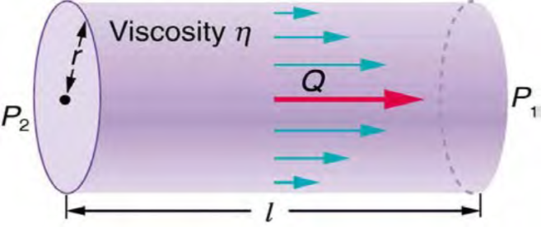
4.2 Poiseuille’s law
In steady flow the fluid in a tube is not accelerating, and an equation relating the pressure gradients to the viscous shear stresses can be derived by consideration of the equilibrium of an annulus of the fluid.
For the Newtonian fluid the velocity profile for laminar flow in a tube is parabolic. The velocity is zero at the wall and reaches a maximum at the centerline.

Slide 27

Poiseuille’s law:
Q = ($P_{2}−P_{1})$ $\frac{π r^{4}}{8ηl}$ Or Q = $\frac{(P_{2}−P_{1})}{R_{h}}$ Or ($P_{2}−P_{1})$ = $\frac{8ηl}{π r^{4}}$ Q
where $R_{h}$ = $\frac{8ηl}{π r^{4}}$ – hydro /hemodynamic resistance.
Poiseuille’s law applies to laminar flow of an incompressible fluid of viscosity η through a tube of length l and radius r . The direction of flow is from greater to lower pressure. Flow rate Q is directly proportional to the pressure difference P2 − P1 , and inversely proportional to the length l of the tube and viscosity η of the fluid. Flow rate increases with r4 , the fourth power of the radius.

Slide 28
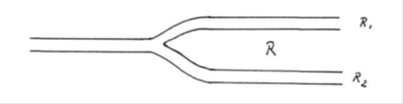

4. 3 Hydrodynamic resistance of a system of tubes
1) Tubes in series
R = $R_{1}$ + $R_{2}$ + $R_{3}$ (resistance add up)
2) Tubes parallel

Slide 29
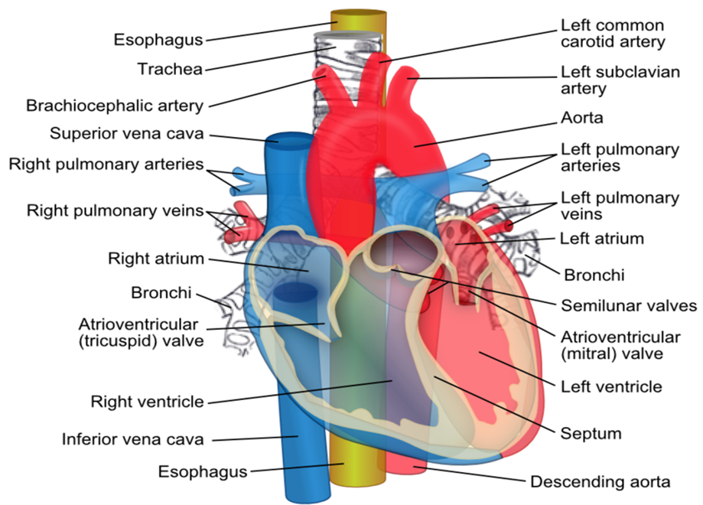
II. The basis of Hemodynamics
The cardiovascular system: Heart – Arteries – Veins
1.1. Heart – double pump system:
Heart – double pump system
Arteries – are blood vessels which transport blood away from the hear
Veins - are blood vessels which transport blood towards the heart

Slide 30
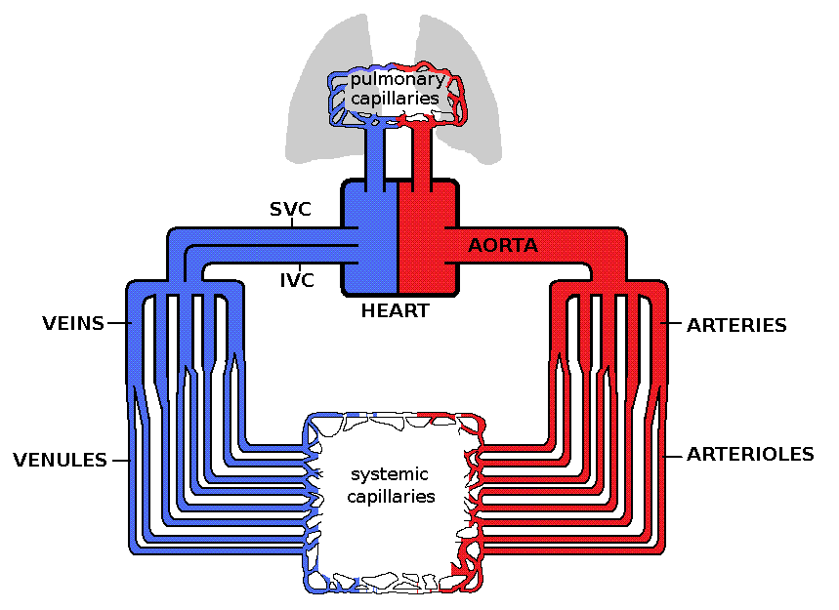

Slide 31
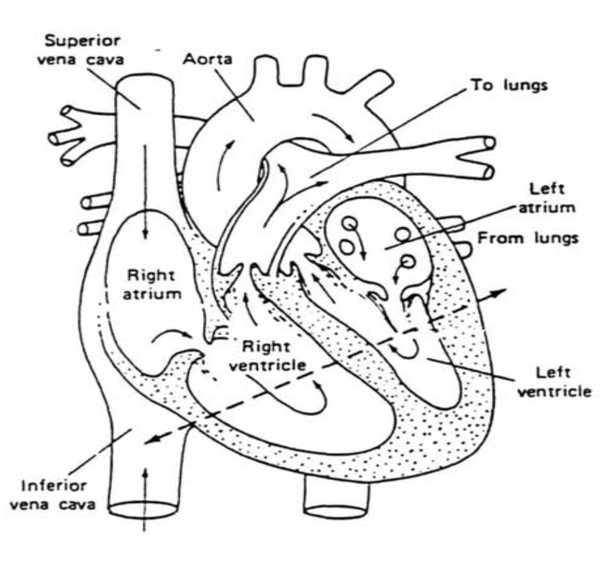

Slide 32
4 Chambers: Left Atrium – Left Ventricle (Left heart) – Right Atrium – Right Ventricle (Right Heart)
4 Valves – are controlled by the pressure conditions in the ventricles caused by the contraction of the heart muscle – increase in pressure closes inlet valve and opens outlet valve. In Such a way valves determine the flow direction of the blood.
2 atrioventricular valves
- The mitral (bicuspid) valve lies between the left atrium and left ventricle
- The tricuspid valve lies between the right atrium and the right ventricle
2 semilunar valves sit at the exit of each of the ventricles
- The aortic valve
- The pulmonary valve

Slide 33
- Left ventricle chamber is compressed by heart muscle (P=125 mm Hg)
- Blood is pumped through the Aorta into the large Systemic Cycle which closes at right atrium (2 veins – Superior Vena Cava and Inferior Vena Cava)
- Blood is pumped by weak contraction (P=6 mm Hg) to right ventricle chamber
- Right ventricle chamber compresses (P=25 mm Hg) and pumps blood through 4 pulmonary arteries into the small Pulmonary Cycle which closes at left atrium
- The left atrium receives oxygenated blood back from the Pulmonary Cycle via one of the 4 pulmonary veins
- Blood is pumped by weak contraction (P=8 mm Hg) to left ventricle.

Slide 34

The amount of work done by heart (heart muscle) can be calculated from the force F developed by heart muscle and linear change in the heart chamber size, or in terms of blood pressure on the surface area of the heart chamber and the change of its volume:
$W_{H}$ = $\int{F}$ $∙$dl = $\int{\frac{F}{S}}$ $∙ S$dl = $\int_{V_{s}}^{V_{d}}{P(V)}∙$dV = $P_{mean}∙∆$V
where:
$P(V)$ – the blood pressure in a ventricle with respect to its volume;

Slide 35

$V_{s}$ - End-systolic volume (ESV) - is the volume of blood in a ventricle at the end of contraction, or systole, and the beginning of filling, or diastole (the lowest volume of blood in the ventricle at any point in the cardiac cycle);
$V_{d}$- End-diastolic volume (EDV) - is the volume of blood in a ventricle at the end of diastole or filling in, or the amount of blood in a ventricle just before systole.
$P_{mean}$ – the mean blood pressure in the ventricles;
$∆$V - the pumped blood volume per beat. The volume of the pumped blood during each compression is called Stroke Volume (SV):
$SV=$ $∆$V = $V_{d}$ - $V_{s}$ = EDV – ESV
$W_{H}$ = $P_{mean}∙$ (EDV – ESV)

Slide 36

Mean arterial pressure $P_{mean}$(MAP) represents the “average” pressure of blood in the arteries, that is, the average force driving blood into vessels.
$P_{mean}$ be approximated by adding the diastolic pressure to one-third of the pulse pressure or systolic pressure minus the diastolic pressure:
$P_{mean}$ = $P_{d}$ + $\frac{P_{s}−P_{d}}{3}$

Slide 37
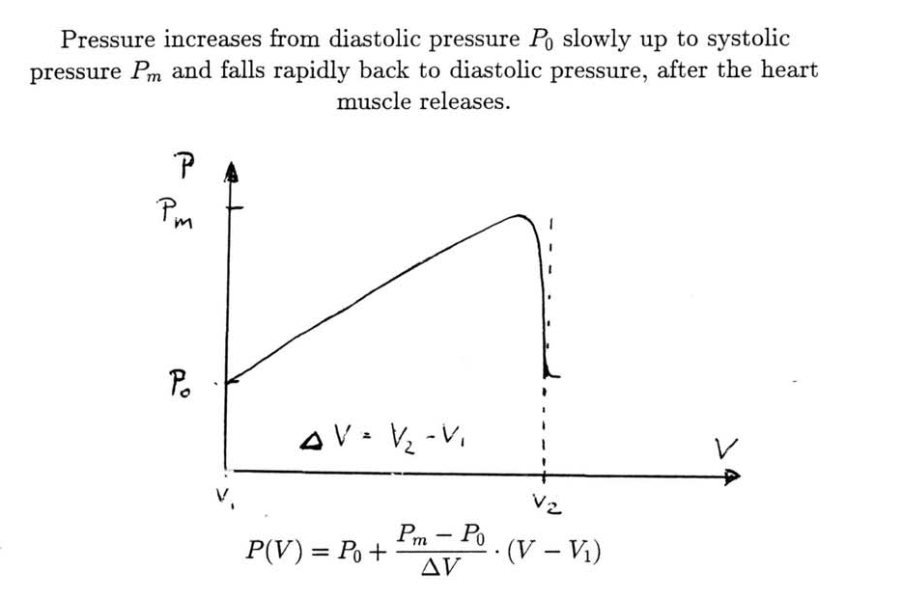

Slide 38

The Frank–Starling law:
The stroke volume of the heart increases in response to an increase in the volume of blood filling the heart (the end diastolic volume) when all other factors remain constant.
An ejection fraction (EF) is the fraction of blood ejected from a ventricle with each heartbeat
EF = $\frac{∆V }{V_{d}}$ $= \frac{SV}{EDV}$ = (66 – 67) %
Cardiac output Q (CO) – the volume of blood being pumped by a ventricle per unit of time:
Q = $∆$V $∙$ f = $SV∙$ $H_{r}$
The normal range for CO is 4.0 – 8.0 (L / min)

Slide 39
2. Blood Volume, Blood Pressure and Blood Flow Velocity Distribution
2.1. Blood Volume Distribution
Heart | Systemic Cycle | Pulmonary Cycle
7.2 % | 84 % | 8.8 %
arteries | 6.0 | 2.6
arterioles | 8.0
capillaries | 6.0 | 2.2
small veins | 46.0 | 4.0
large veins | 18.0

Slide 40

The total blood mass is $≈$ 7% of the total body mass. The blood density
$ρ$= 1.05 · ${10}^{3}$ $\frac{kg}{m^{3}}$

Slide 41

2.2. Blood Pressure and Blood Flow Velocity Distribution
Region | Blood Pressure (mmHg) Ps / Pd and Pav | peak flow velocity / average
Left Ventricle | 120 / 10
Aorta | 120 / 70 | (100 – 250) cm/s ascending aorta / 30 cm/s
Artery | 95 - 90 | 25 cm/s Common iliac artery
Arterioles | 70 - 35
Capillaries | 30 - 15 | (1 - 0.3) $∙{10}^{−3}\frac{m}{s}$(1 - 0.3 mm/s)
Small vein | 15 - 10
Vena Cava | 10 - 4 | (5 – 40) cm/s
Right Atrium | 4 - 5
Right Ventricle | 25 / 5

Slide 42
Schematic of the circulatory system
Blood Pressure Distribution (Gauge pressure in mm Hg)

Slide 43
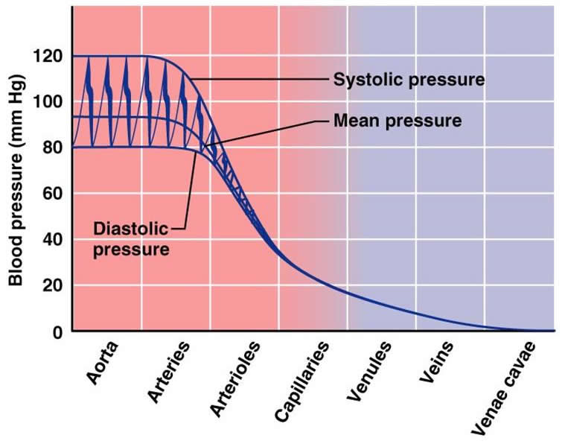

Slide 44
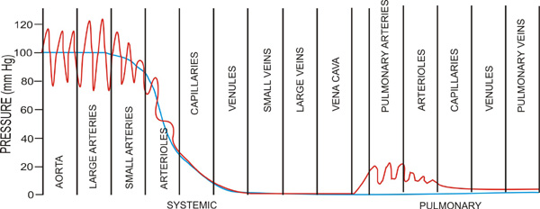

Slide 45
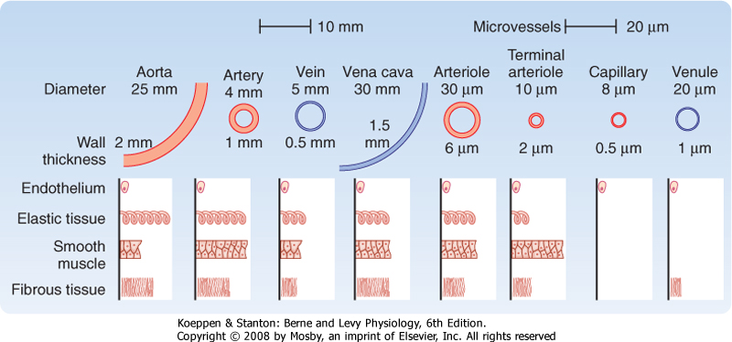

Slide 46
References
1.Medical and Biological Physics. Part ІІ / [ V.I. Fediv, O.I. Olar, O.Y. Mykytiuk, V.F. Boiechko]. Textbook for students of higher medical education institutions – Chernivtsi: BSMU Publishing House, 2017. - 235 p.
5. Internet resources:
Medical Physics https://www3.nd.edu/~nsl/Lectures/mphysics/
https://en.wikipedia.org/wiki/Hemodynamics

