Slide 1
Physical bases
of electrocardiography

Slide 2
Electrocardiography in general
Electrocardiography (ECG or EKG) – the method of registration and recording of the electrical activity of the heart.
Electrocardiogram is the graphical representation of the process of depolarization and repolarization of cardiac muscle during a cardiac cycle.

Slide 3
Electrocardiogram as itself is the graph of change in electric potential difference (voltage) between pairs of selected points (leads) over time which is detected by electrodes placed on the skin.
The process of depolarization of cardiac muscle precedes in norm its contraction and therefore electrocardiogram serves as the source of information on heart functioning, particularly different cardiac abnormalities, including cardiac rhythm disturbances.
ECG is used to measure the rate and rhythm of heartbeats, the size and position of the heart chambers, the presence of any damage to the heart's muscle cells or conduction system.

Slide 4
Electrical conduction system of the heart
Electrical conduction system of the heart is a set of groups of specific heart muscle cells specialised for electrical conduction and which transmits electrical impulse (the wave of depolarization) throughout the heart.

Slide 5
Electrical conduction system of the heart
Sinoatrial node (SA node) - the cardiac pacemaker located in the wall of the right atrium
Bachmann's bundle– conducts impulse to the left atrium
Atrioventricular node (AV node) -located between the atria and the ventricles at the inferior end of the interatrial septum and conducts the electrical impulse from the atria to the ventricles
Bundle of His / His bundle (BH/HB) and its left and right branches which conduct impulse to the left and right ventricles respectively
Purkinje fibers – spread impulse throughout the ventricles

Slide 6
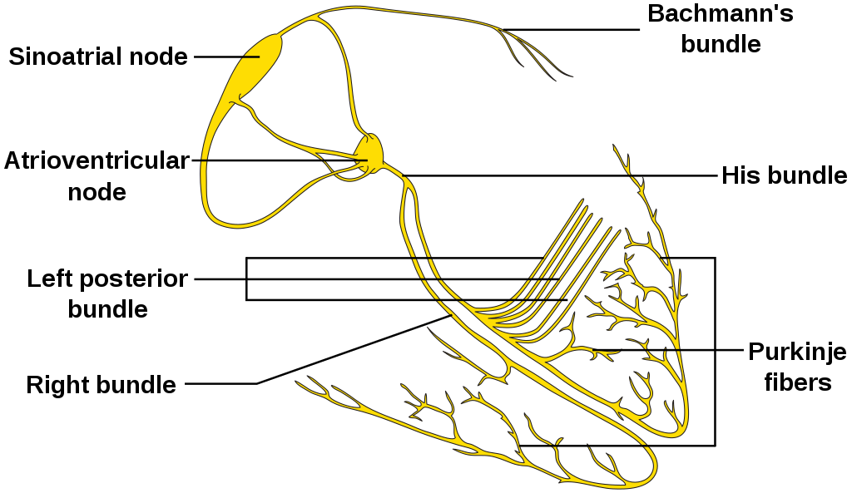
Electrical conduction system of the heart

Slide 7
The wave of depolarization (action potential) starts in in the SA node, spreads throughout the atrium, and passes through the AV node along the bundle of His and into the Purkinje fibers, spreading throughout the ventricles to cause contraction of the heart muscle.
The electrical impulse due to the wave of depolarization stimulates contraction first of the right and left atrium, and then the right and left ventricles.

Slide 8
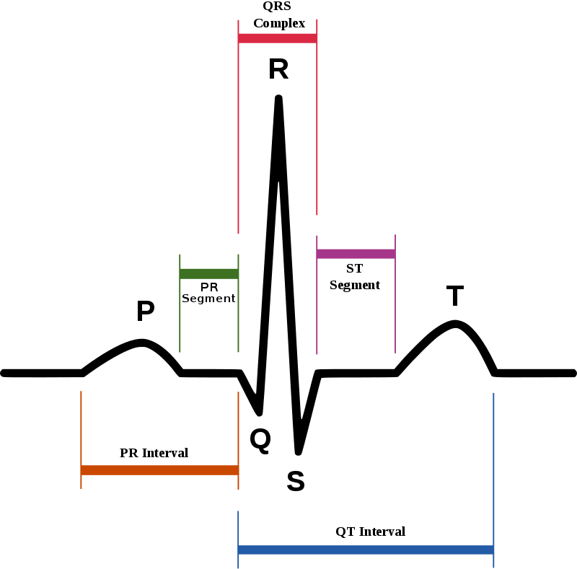
Components of electrocardiogram

Slide 9
Formation of electrocardiogram
1. Electrical impulse is spontaneously generated by the SA node (the cardiac pacemaker).
This impulse is propagated throughout the right atrium, and through Bachmann's bundle to the left atrium, stimulating the myocardium of the atria to contract.
The conduction of the electrical impulses throughout the atria is seen on the ECG as the P wave.

Slide 10
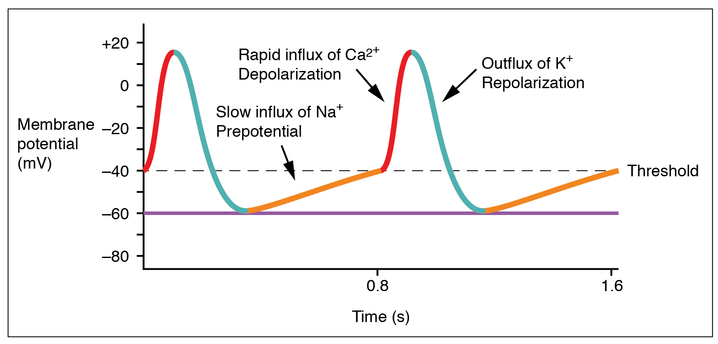
SA node action potential

Slide 11
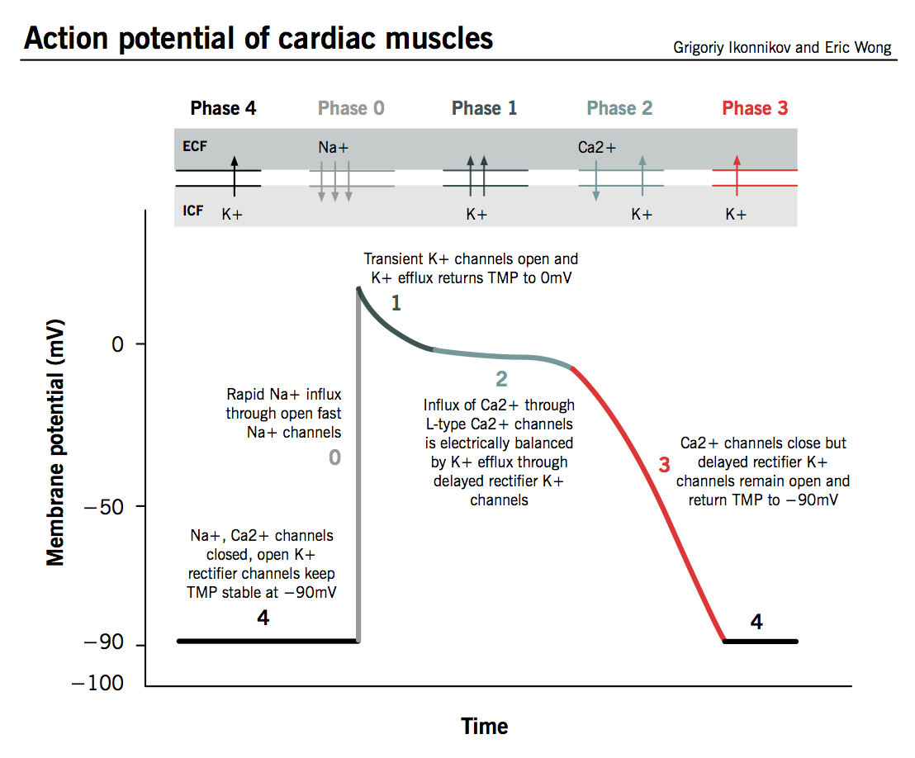

Slide 12
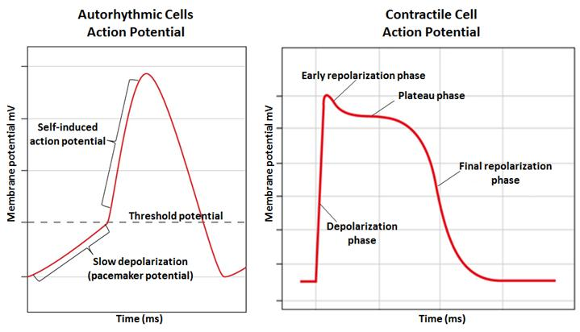

Slide 13
2. Atrial to ventricular delay corresponds to the PR interval which is measured from the beginning of the P wave to the beginning of the QRS complex. This interval reflects the time the electrical impulse takes to travel from the SA node through the AV node (120 to 200 ms).
The atrial to ventricular delay is needed for consecutive contraction of atria first and then ventricles to perform proper pumping function of the heart.
3. Depolarization of the right and left ventricles - QRS complex.
4. The ventricles are depolarized - ST segment.
5. Repolarization of the ventricles – T wave.

Slide 14
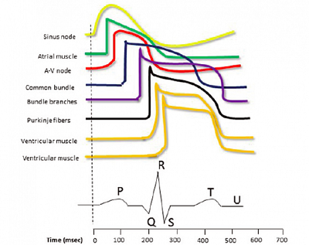

Slide 15
Physical model of ECG
Wilson-Einthoven theory :
The heart is an electrical generator (time-varying current dipole) placed in isotropic conductive medium
The human body is a part of infinite, homogeneous conductor
Electric potentials generated by heart can be represented by the potentials at vertices of an equilateral triangle which are generated by current dipole the source of which is centered in the triangle, and direction of which changes during the cardiac cycle.

Slide 16
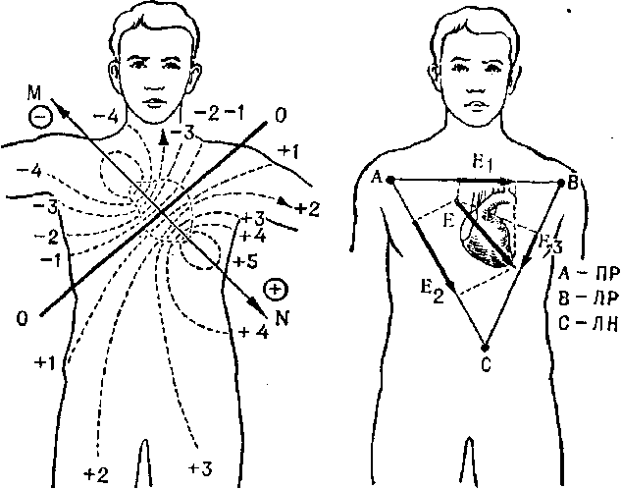

Slide 17
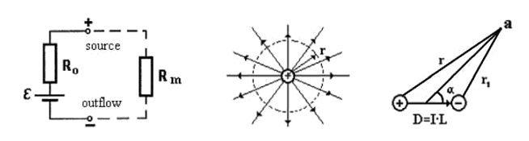
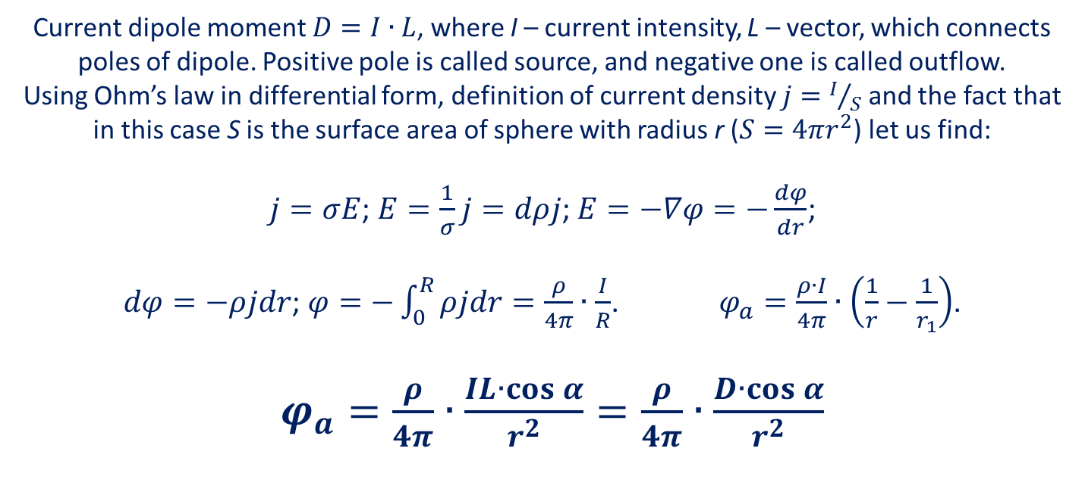
Current dipole moment $D=I∙L$, where I – current intensity, L – vector, which connects poles of dipole. Positive pole is called source, and negative one is called outflow.
Using Ohm’s law in differential form, definition of current density $j=I/S$ and the fact that in this case S is the surface area of sphere with radius r ($S=4πr^{2}$) let us find:
$j=σE$; $E=\frac{1}{σ}j=dρj$; $E=−∇φ=−\frac{dφ}{dr}$;
$dφ=−ρjdr$; $φ=−\int_{0}^{R}{ρjdr=\frac{ρ}{4π}∙\frac{I}{R}}$. $φ_{a}=\frac{ρ∙I}{4π}∙\left(\frac{1}{r}−\frac{1}{r_{1}}\right)$.
$φ_{a}=\frac{ρ}{4π}∙\frac{IL∙\cos{α}}{r^{2}}=\frac{ρ}{4π}∙\frac{D∙\cos{α}}{r^{2}}$

Slide 18
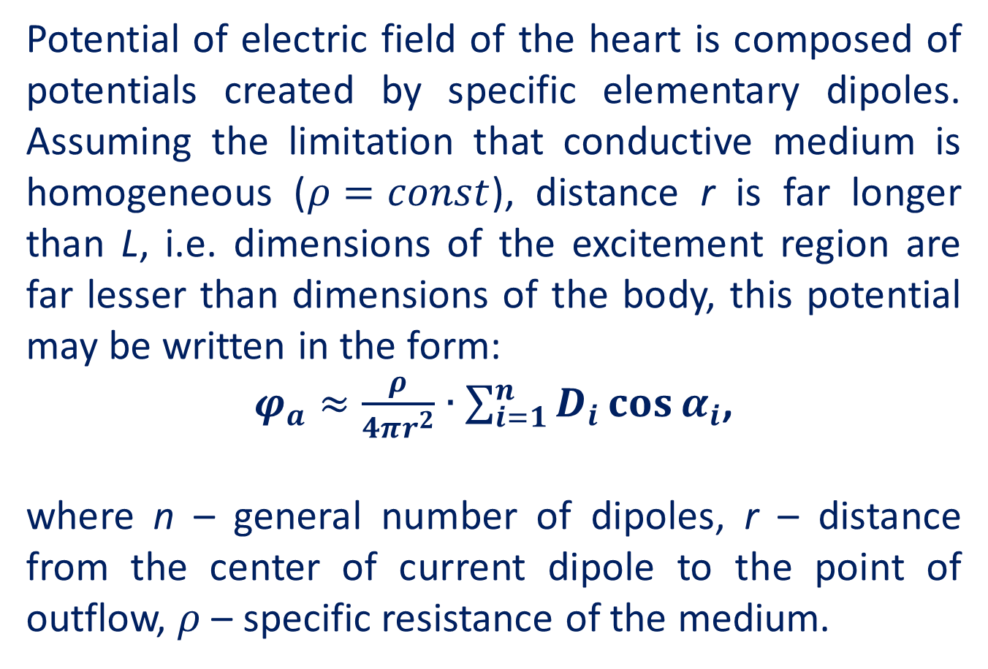
Potential of electric field of the heart is composed of potentials created by specific elementary dipoles. Assuming the limitation that conductive medium is homogeneous ($ρ=const$), distance r is far longer than L, i.e. dimensions of the excitement region are far lesser than dimensions of the body, this potential may be written in the form:
$φ_{a}≈\frac{ρ}{4πr^{2}}∙\sum_{i=1}^{n}{D_{i}\cos{α_{i}}}$,
where n – general number of dipoles, r – distance from the center of current dipole to the point of outflow, $ρ$ – specific resistance of the medium.

Slide 19
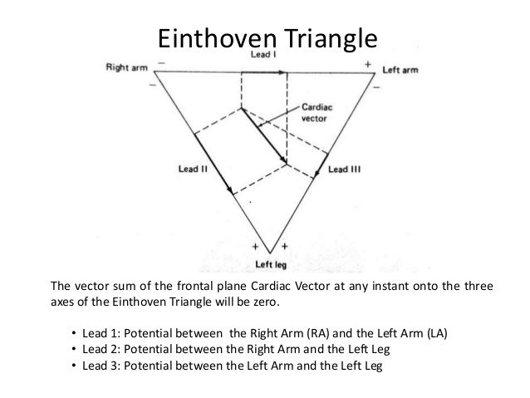

Slide 20
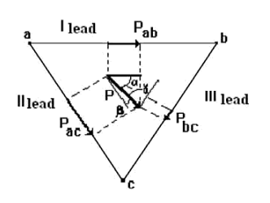
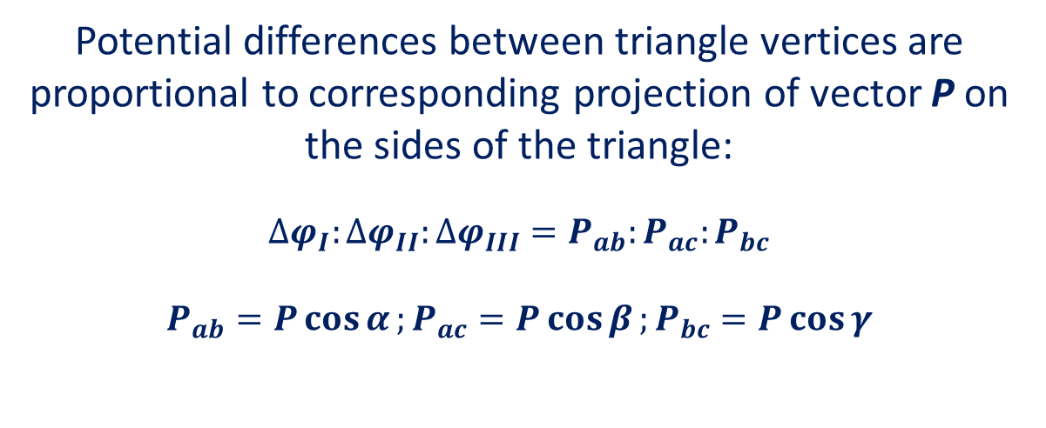
Potential differences between triangle vertices are proportional to corresponding projection of vector P on the sides of the triangle:
$$∆φ_{I}:∆φ_{II}:∆φ_{III}=P_{ab}:P_{ac}:P_{bc}$$
$$P_{ab}=P\cos{α};P_{ac}=P\cos{β};P_{bc}=P\cos{γ}$$

Slide 21
Limb leads
Lead I is the voltage between the (positive) left arm (LA) electrode and right arm (RA) electrode:
I = LA - RA
Lead II is the voltage between the (positive) left leg (LL) electrode and the right arm (RA) electrode:
II = LL - RA
Lead III is the voltage between the (positive) left leg (LL) electrode and the left arm (LA) electrode:
III = LL – LA
The use of other electrodes (neutral – on the right leg and thoracic applied to the corresponding point of the thorax) makes it possible to use other types of standard leads. There are more than two tens of them in cardiology.

Slide 22
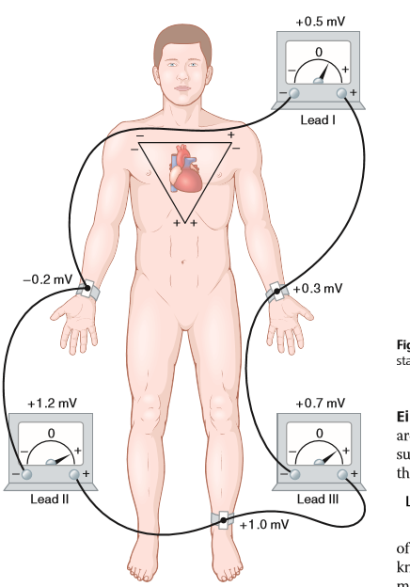

Slide 23
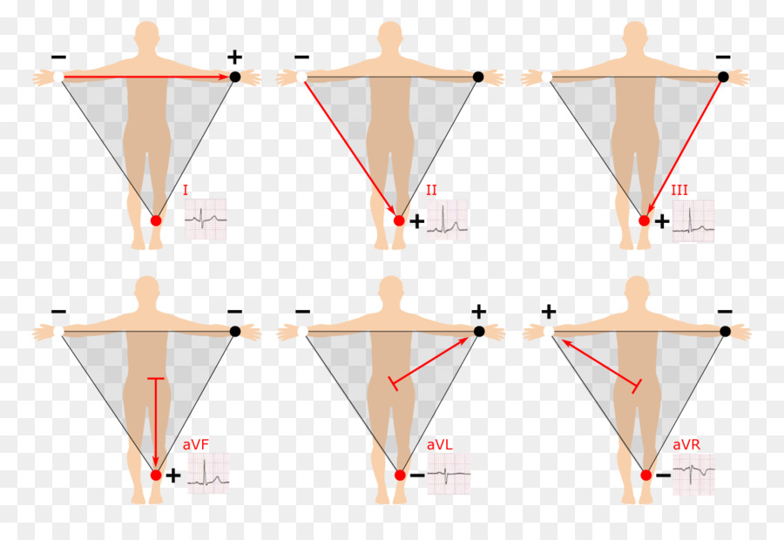

Slide 24
Typically the scan proceeds with 25 mm/s and the signal strength is plotted as 10mm/mV.

Slide 25
