Slide 1
Fundamentals of Rheography
- rheography (“rheo” – flow, “grapho” – write) diagnostic method in which blood flow is investigated in specific organs and tissues, and the whole body in general
- the bottom line is rheography graphic recording with the help of a special device - rheograph - changes in the electrical conductivity (resistance) of the body, caused by the pulse fluctuations of blood flow
- the body blood has the high electrical conductivity (low resistance), during systolic contraction of the heart when the blood flows into nearby bodies electrical conductivity of these parts of the body will be high (resistance – low) and the moment of cardiac muscle relaxation (diastole), opposite – low, based on the testimony rheograph output curve of pulse oscillation, called rheogram

Slide 2
Specific electric resistance of
biological tissues
tissue | ρ, Ohm ·m | tissue | ρ, Ohm ·m
cerebro-spinal fluid (neurolymph) | 0.55 | fat | 33.3
blood | 1.66 | dry skin | 10⁶
muscles | 2 | bone without periosteum | 10⁷
cerebral and nerve | 14.3

Slide 3
Impedance. Equivalent schemes of biological tissues

Slide 4
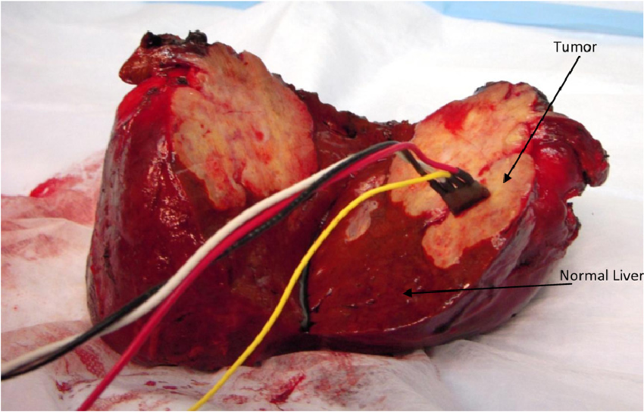

Slide 6
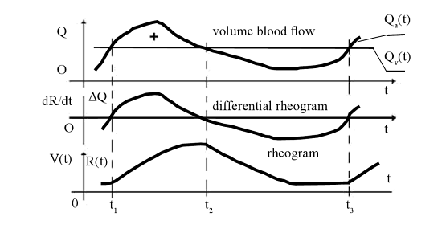

Slide 7
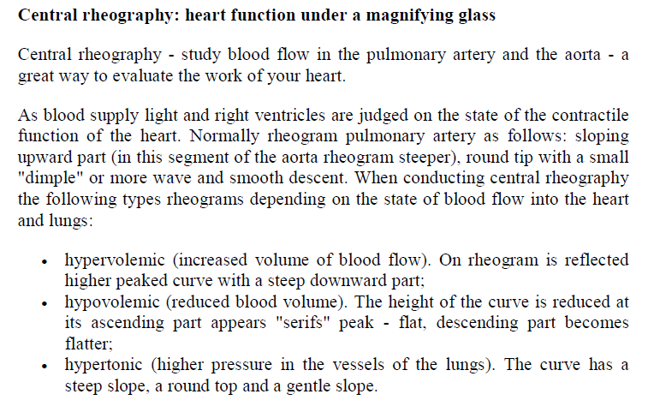

Slide 9
Anacrotism, catacrotism, incisure

Slide 10
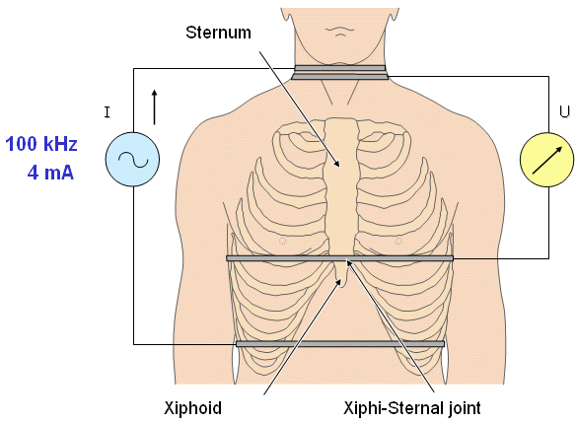
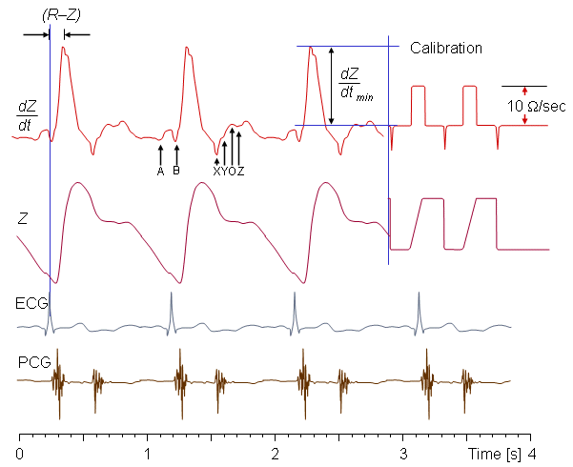

Slide 11
right pulmonary artery blood flow

Slide 12


Calculation of stroke volume

