Slide 1
Physical bases of Physiotherapy

Slide 2
Alternating Electromagnetic Field
- Any alternating electric field generates rotational magnetic field
- Any alternating magnetic field generates rotational electric field
- So, changing with time electric and magnetic fields generate each other, and exist in the form of electromagnetic waves

Slide 3
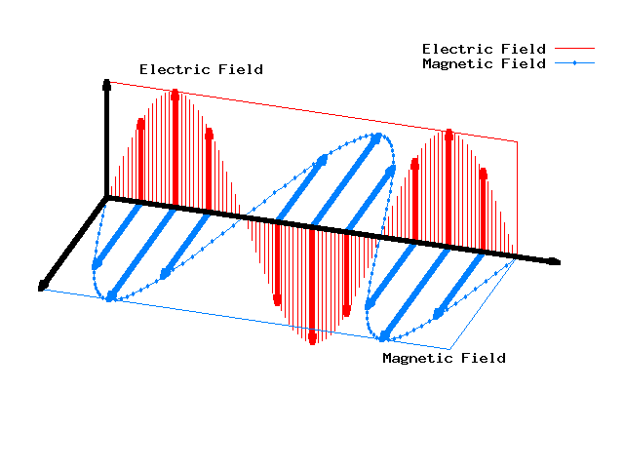
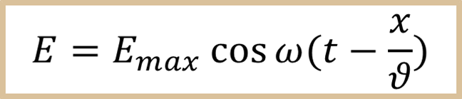
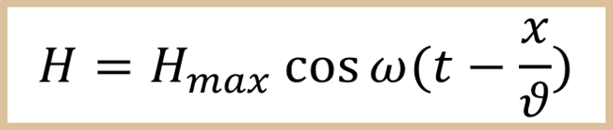
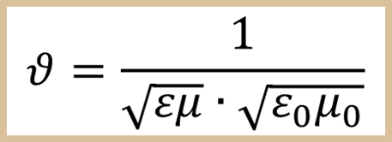
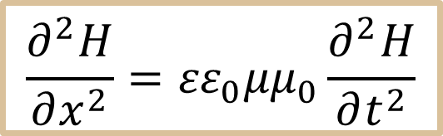
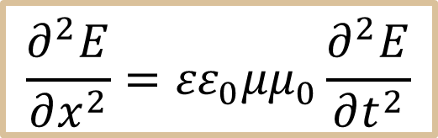
Equations of electromagnetic waves:
$$\frac{∂^{2}E}{∂x^{2}}={εε}_{0}{μμ}_{0}\frac{∂^{2}E}{∂t^{2}}$$
$$\frac{∂^{2}H}{∂x^{2}}={εε}_{0}{μμ}_{0}\frac{∂^{2}H}{∂t^{2}}$$

Slide 4
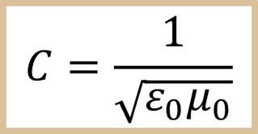



Speed of electromagnetic wave propagation:
- in vacuum
- in medium
- Electromagnetic wave is a process of propagation of electromagnetic oscillations in space;
- Electromagnetic wave is transverse.

Slide 5
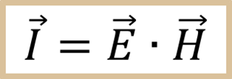
Energy flux density vector of electromagnetic field is equal to
Direction of its transfer coincides with cross-product [E • H]
Characteristics of Electromagnetic Energy:
Transmitted without a medium;
Travel in a straight line;
Reflected, Refracted, Absorbed, Transmitted.

Slide 6
Frequency f, Hz | Radiation type
10³–10¹² | Radio waves
1.5·10¹¹–3.75·10¹⁴ | Infrared radiation
(3.75-7.5)·10¹⁴ | Visible light
7.5·10¹⁴–3·10¹⁶ | Ultraviolet radiation
3·10¹⁶–3·10²² | X-ray
>3·10¹⁸ | γ-radiation

Slide 7
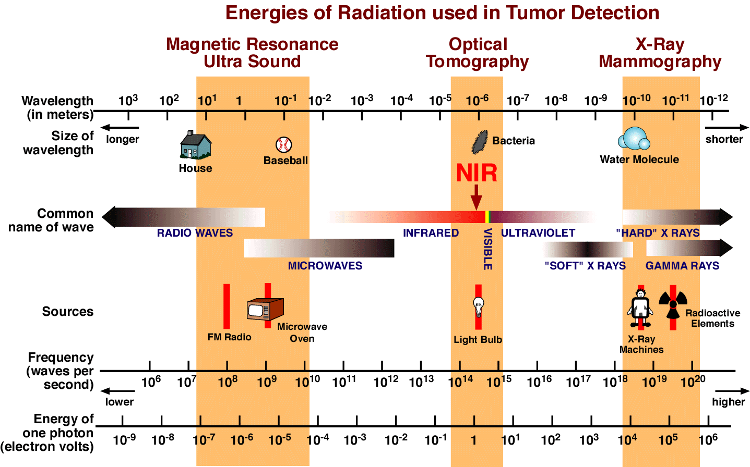

Slide 8
Frequency f, Hz | Radiation type | Wavelength X, m
3–30 | Far law | 10⁸–10⁷
30–300 | Extremely law (megametric) | 10⁷–10⁶
(0.3–3)·10³ | Infralow (hecakilometric) | 10⁶–10⁵
(3–30)·10³ | Very law | 10⁵–10⁴
(30–300)·10³ | Low frequency (kilometric) | 10⁴–10³
(0.3–3)·10⁶ | Medium frequency (hectometric) | 10³–10²
(3–30)·10⁶ | High frequency (decametric) | 100–10
(30–300)·10⁶ | Very high (metric) | 10–1
(0.3–3)·10⁹ | Ultrahigh (UHF) (decimetric) | 1–0.1
(3–30)·10⁹ | Superhigh (SHF) (centimetric) | 0.1–0.01
(30–300)·10⁹ | Extremely-high (EHF) (milimetric) | 0.01–0.001
(0.3–3)·10¹² | Hyperhigh (HHF) (decimilimetric) | (10.01)–10⁻³

Slide 9
With medical purposes the following manifestation of electromagnetic field interaction with biological systems are mainly applied.
excitation (electrostimulation); as a rule law frequency field with impulses of different forms are used;
therapeutic heating using high frequency fields (diathermy, inductothermy, UHF, microwave therapy)
specific action; its specific feature is a response of biological systems to extremely low intensities insufficient for excitation and heating. This action mechanism covers all bands of wavelength and is characterised by high selectivity (rather narrow frequency band for particular types of cells).

Slide 10
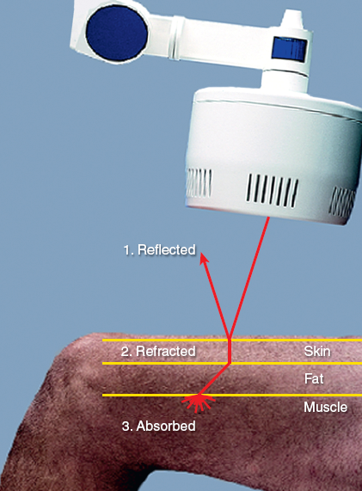
When electromagnetic radiations contact human tissues, it may be reflected, refracted or absorbed. Energy that is transmitted through the tissues must be absorbed before any physiological changes can take place.

Slide 11
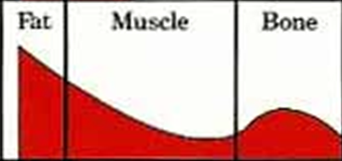

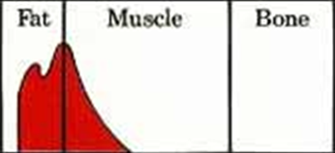
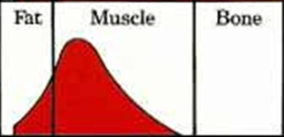
Microwave
Most microwave energy is absorbed in the subcutaneous fatty layer, where it produces an undesirable heat buildup with little therapeutic value. Penetration into muscle tissue is less deep compared to shortwaves.
Shortwave: Condenser Field With 2 Opposite Pads
Condenser pads mainly produce superficial heat with absorption in fatty layer. Although heat penetrates through the muscle layer, it also is generated in the bony tissue.
Shortwave: Induction Field-Helical Coil/Drum
A shortwave induction field creates very little heat in the fatty layer. Most of the heat is created in the muscle tissue, where it has the greatest therapeutic effect.

Slide 12
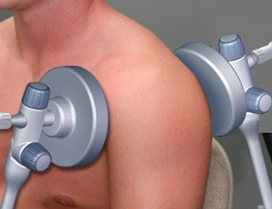
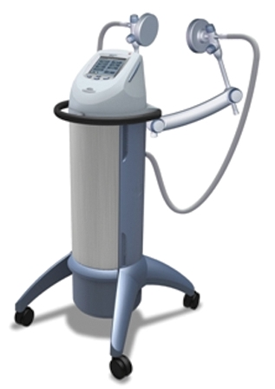
Methods: UHF, SHF and EHF therapy based on the action of ultra, super and extremely high frequency electromagnetic field.
These methods are characterized by absence of electric contact between electrodes and tissue of a patient, i.e. conditions appear, which prevent generation of conduction currents.

Slide 13
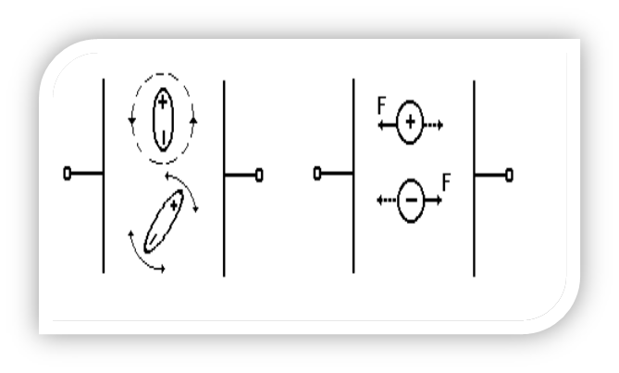
Heating mechanism
Electrolyte. The action of bias electric field causes oscillatory-forward movement of ions (fig. 1b). Amplitude of such forced oscillations depends both on external force and properties of media (for example, viscosity of electrolyte, size of molecules, degree of ion hydration, etc.).
Dielectrics. If dielectric molecules possess their own dipole moment, then qualitatively bias currents may be represented as oscillatory-rotary movement of dipoles in alternating electric field (fig. 1а).
Fig. 1. а) dipole dielectric,
b) electrolyte.

Slide 14
Passage of electrical current through biological tissues results in following effects:
Thermal – diathermies;
Physiochemical – monophasic currents;
Physiological – various types of muscle
/ nerve stimulation.

Slide 15
Specific electric resistance of
biological tissues
tissue | ρ, Ohm ·m | tissue | ρ, Ohm ·m
cerebro-spinal fluid (neurolymph) | 0.55 | fat | 33.3
blood | 1.66 | dry skin | 10⁶
muscles | 2 | bone without periosteum | 10⁷
cerebral and nerve | 14.3

Slide 16
Electric properties of cells

Slide 17
Effect of electric current on biological tissue

Slide 18
In UHF and especially in EHF and SHF methods
it is observed resonant absorption of energy with no increase of temperature that results in structural and functional changes of biologically active molecules.
Groups of atoms included into the structure of biologically active molecules have their own excitation frequencies and absorption (mainly such frequencies are specific for oscillatory-rotary spectral region).

